Slide 1
Web Analytics
Mitchell Teixeira
mitchell@onceinaweb.com

Slide 2

Background about me
Involved with data processing since 1988
Building websites and analyzing web activity since 1996
B2B and B2C sites of all sizes

Slide 3
Perspective
My primary perspective is from a Web Analytics implementation point of view (I’m not a marketer)

Slide 4
Objectives
What is Web Analytics
Concepts
Web Analytics career opportunities
Live analytics tool walkthrough (time permitting)
Questions

Slide 5

What is Web Analytics?
According to the
Digital Analytics Association
(DAA)…
Web Analytics is the measurement, collection, analysis and reporting of Internet data for the purposes of understanding and optimizing Web usage.

Slide 6
Why Web Analytics?
Concepts and tools are approachable and relatable – we all use websites daily
Freely available Google Analytics tool makes it easy to get started
Google Analytics is a “big data” system which handles data collection, data processing and data visualization

Slide 7
Wealth of data elements
As web sites are used each day, a large amount of raw data is generated
This data can be analyzed to learn more about your customers and can allow you to serve them better and capitalize on opportunities and discoveries

Slide 8
Web Analytics software has evolved into a data warehouse
Gather raw web usage data
Analyze using business rules
Provide tools to view, visualize and export reports for further analysis and to join with data from other systems

Slide 9
Web Analytics provides answers to the questions every website owner asks

Slide 10
Who (location, demographics)
What (page views, events)
When (time & date / seasonality)
Where (location, network)
Why (events, clickpath, pages viewed)
How (device type, screen size, network)

Slide 11
Questions and Decisions
What can we quantify?
What can we action upon?
Do we have resources to respond/change/modify
What is really important to our mission?

Slide 12
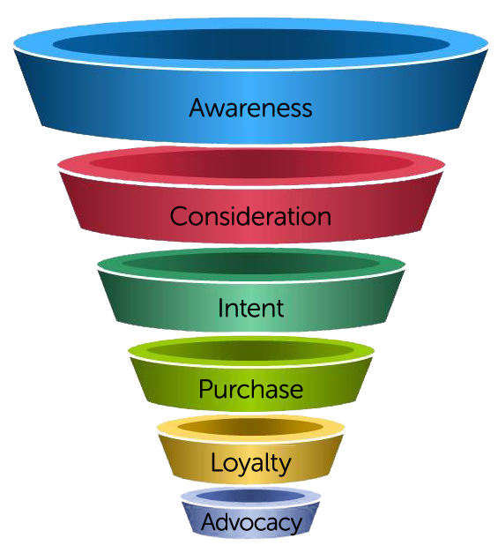
Marketing Funnel

Slide 13
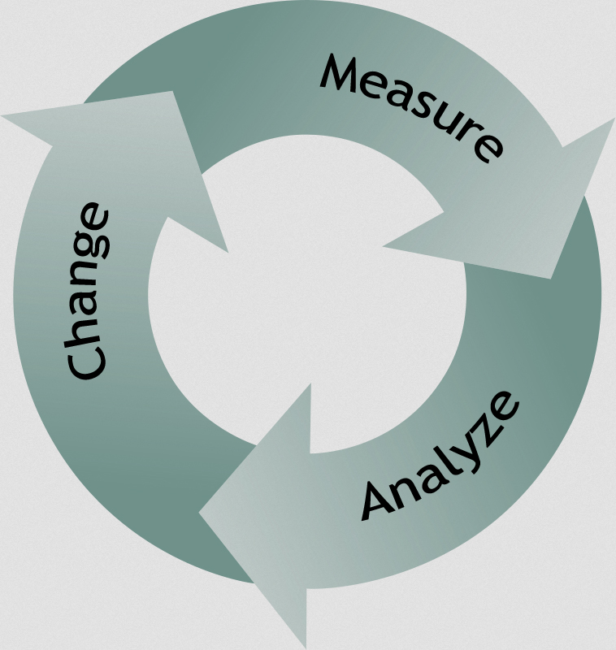
Web Analytics Cycle

Slide 14
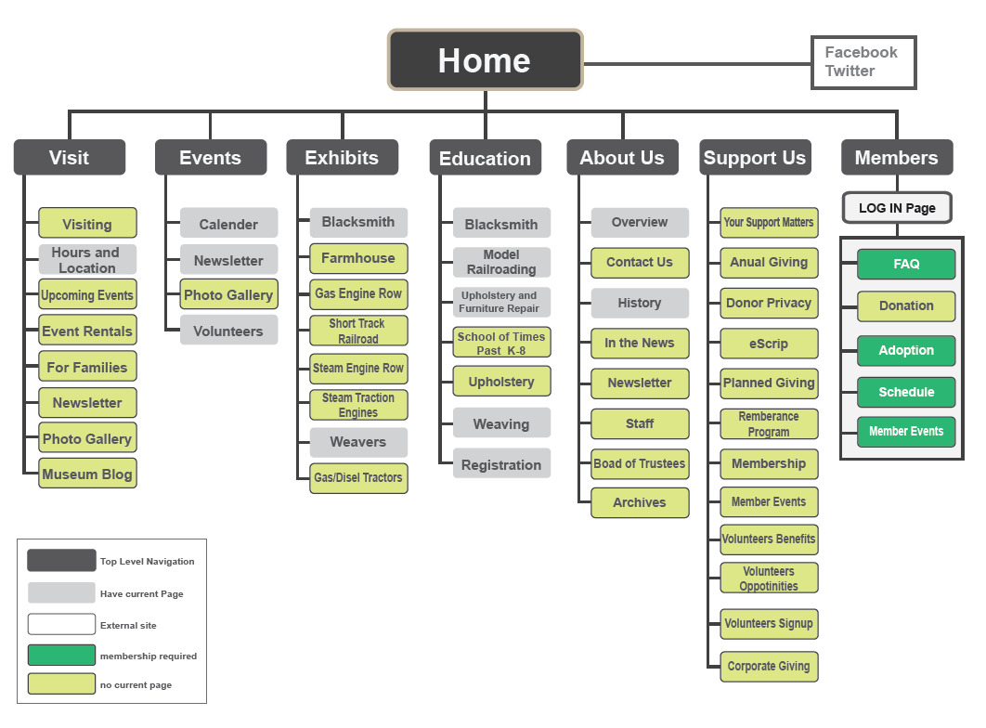
How the Website Was Designed

Slide 15
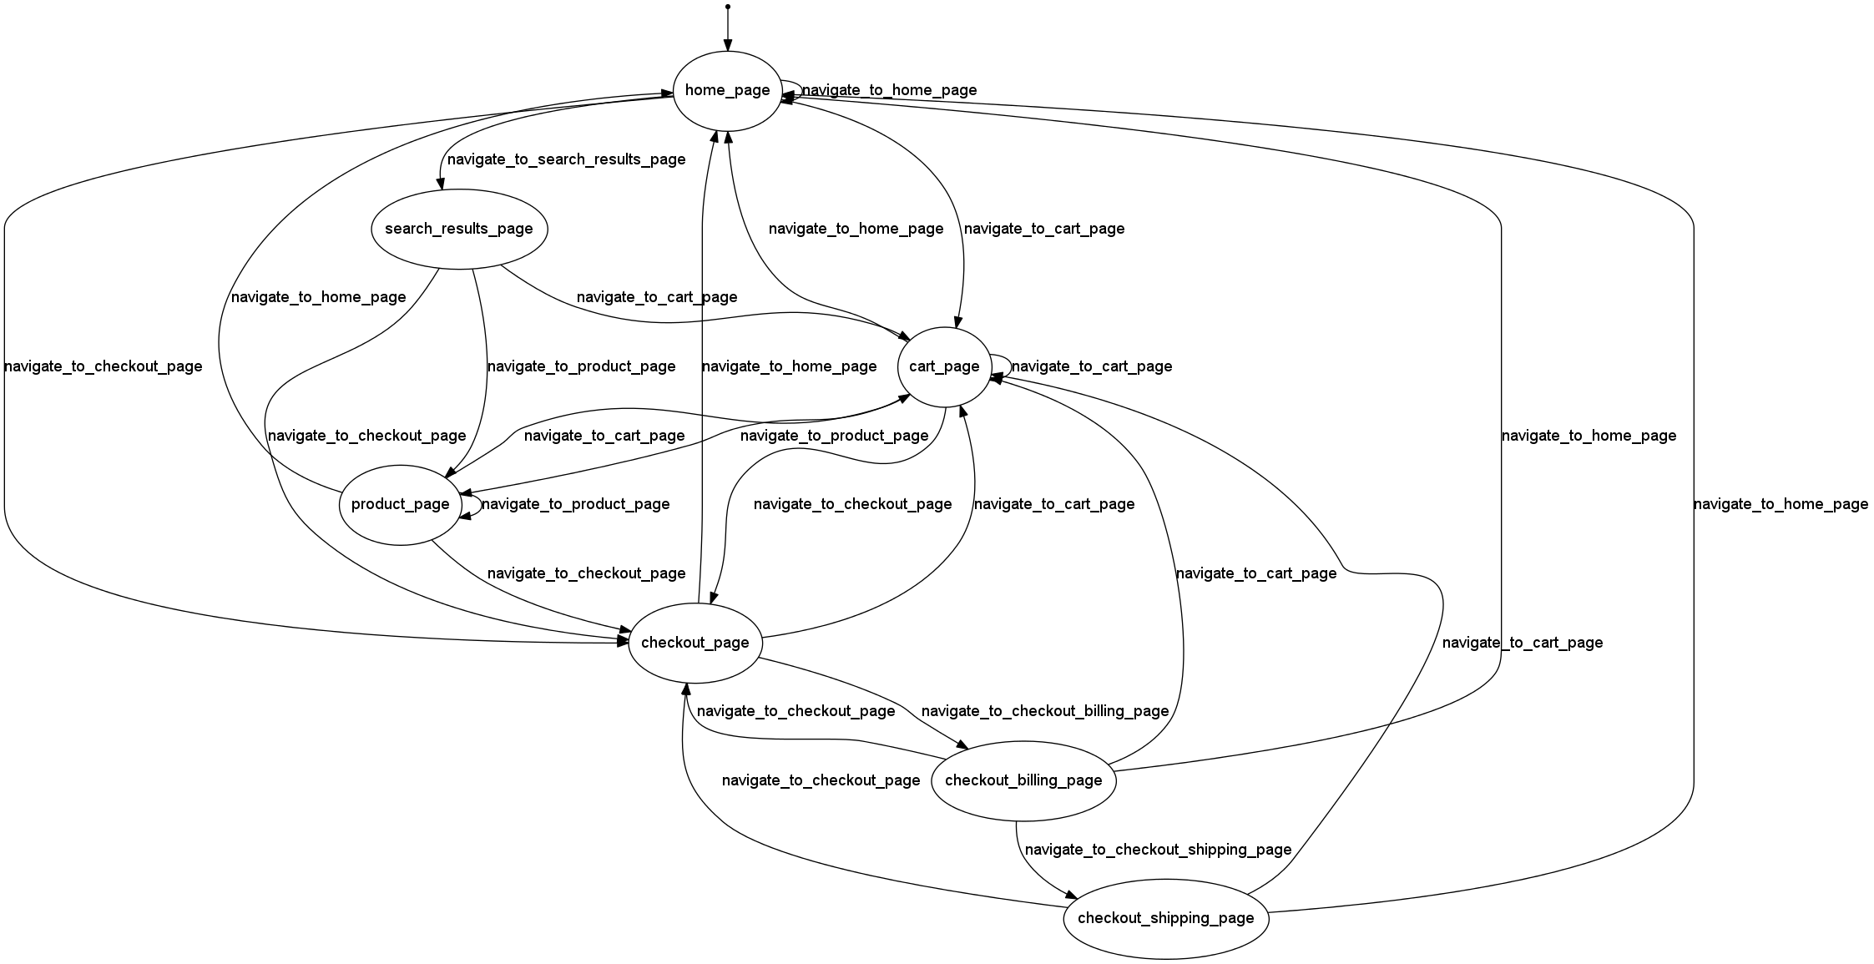
How Visitors Use Your Website

Slide 16
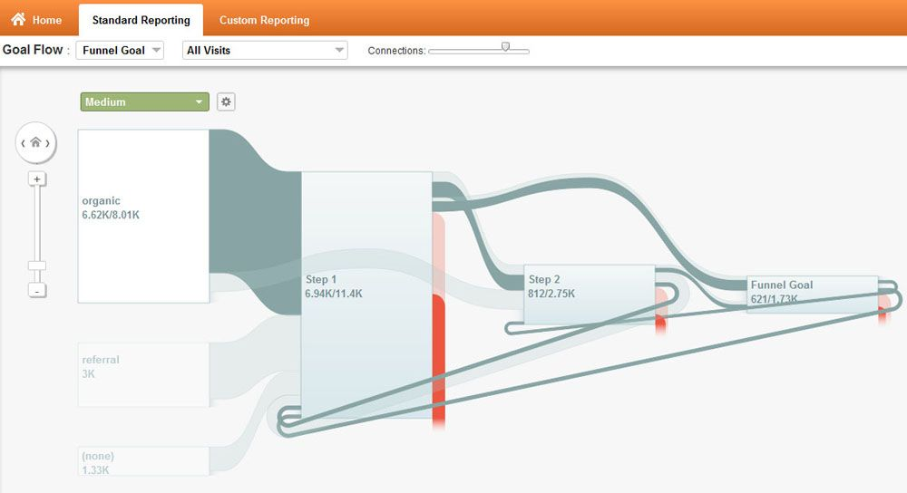
How Visitors Use Your Website

Slide 17
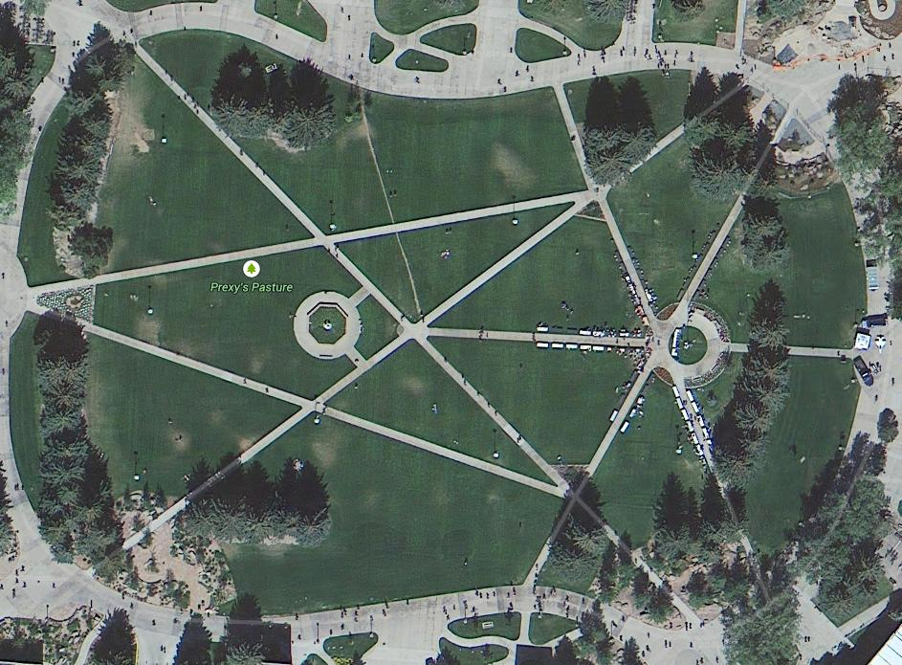
College Quad “desire path” concept

Slide 18
What shall we count / track?
What will your site visitors do on your site that is valuable to your mission?
  Browse / learn
  Purchase
  Register
  Contact
  Track a shipment, order, request, etc.
  Request a quote
  Start a free trial

Slide 19
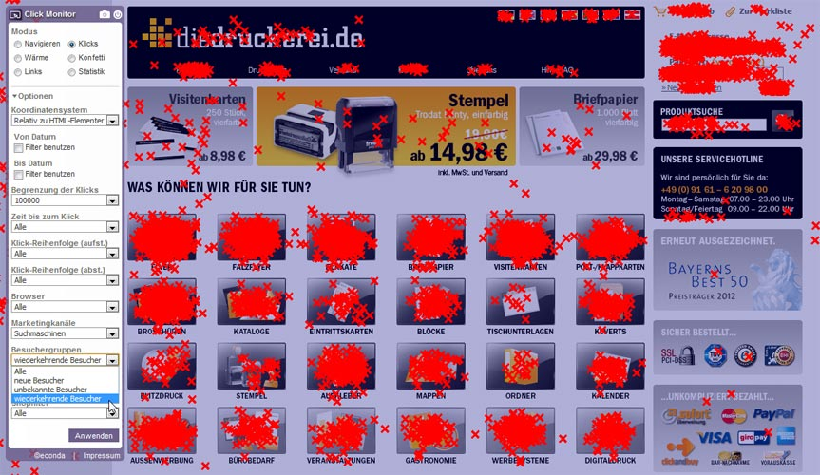
Let’s Track Everything!

Slide 20
Define Metrics for your web venture
Business website?
Government agency site?
Non-profit ?
Hobby / leisure ?
What actions do you want your visitors to take on your site?
Define measurable goals for your website
The metrics most important to your business become your Key Performance Indicators (KPIs)

Slide 21
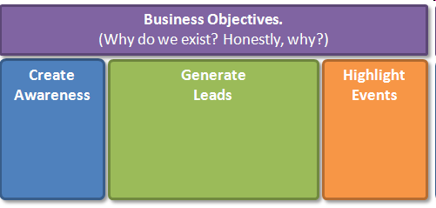
Defining Metrics
(getting started)

Slide 22
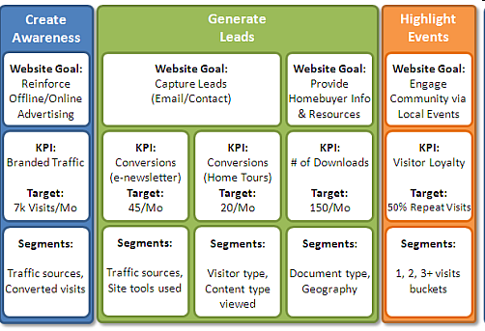
Defining Goals we can measure

Slide 23
Initial Implementation
Register for Google Analytics
Create a web “property” for the site
Download simple “tag”
Install tag on every page of the site

Slide 24
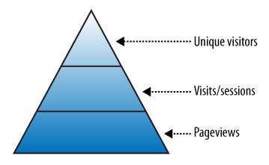
Web Analytics Reports
“Big 3” (building blocks)

Slide 25
Page Views
Count of how many times a page was accessed on your site
Aggregate count of how many times all site pages were viewed
Basically: what did visitors look at,
and how many times did they look?

Slide 26
Visits
Basically, a count of how many times the site was viewed by visitors
Another term for a visit is session. A session includes all the pages a visitor views at one sitting.
Total visits is a count of all the sessions during a given time period
Considered by many to be the most accurate measure of site utilization

Slide 27
Visitors / Unique Visitors
Sometimes simply called uniques
An attempt to quantify site visitors as individual warm bodies or pairs of eyeballs
Caveats
  Technical issues may distort this count
  Same person can view site from multiple computers and is counted each time
  etc.

Slide 28
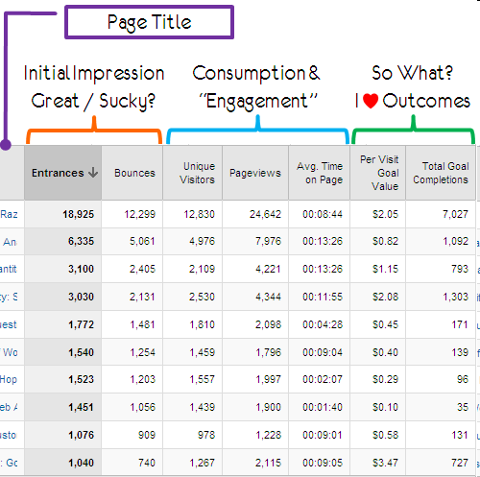
Sample Pages Report

Slide 29
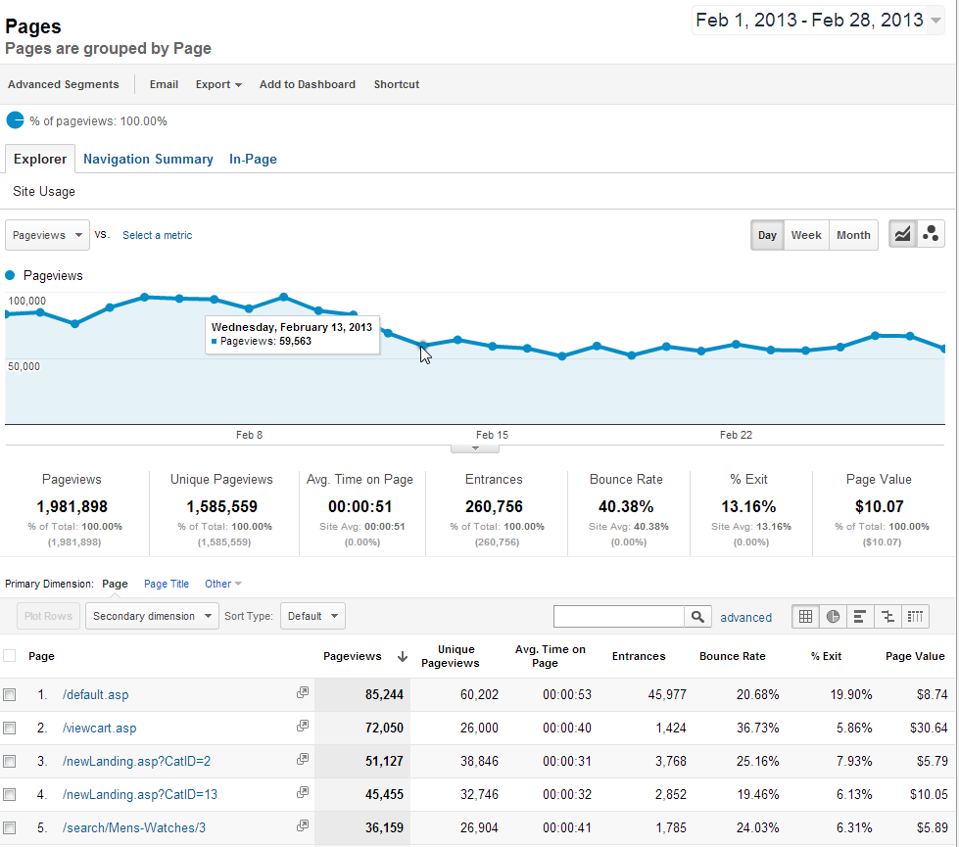

Slide 30
More reports: Traffic
Where is my site’s traffic coming from?
  Direct (typed or bookmarked)
  Organic search
  Paid search (pay-per-click)
  Links
  Social networks
  Other paid campaigns

Slide 31
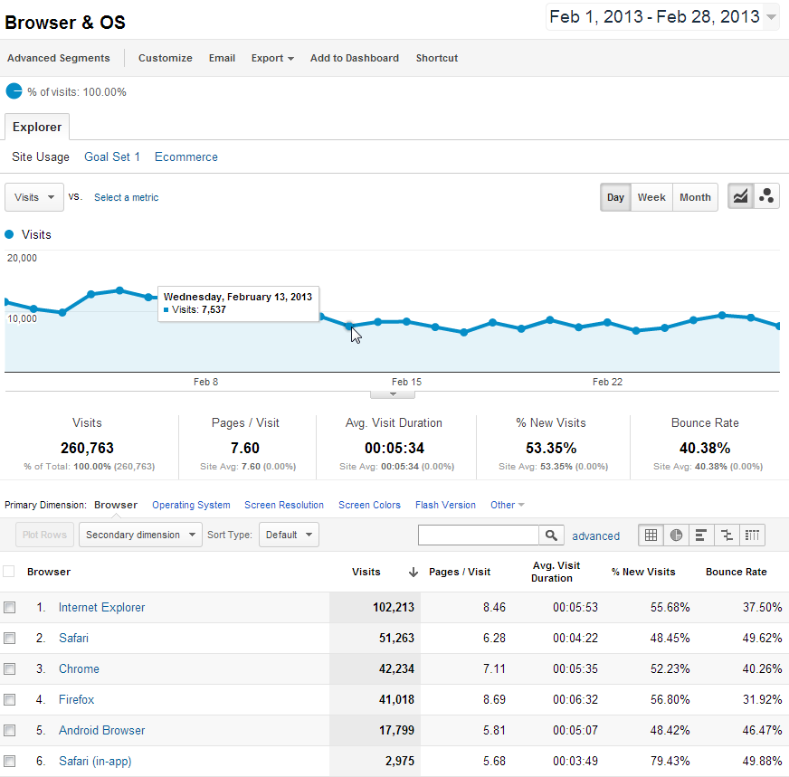
Technology (Browsers) Report

Slide 32
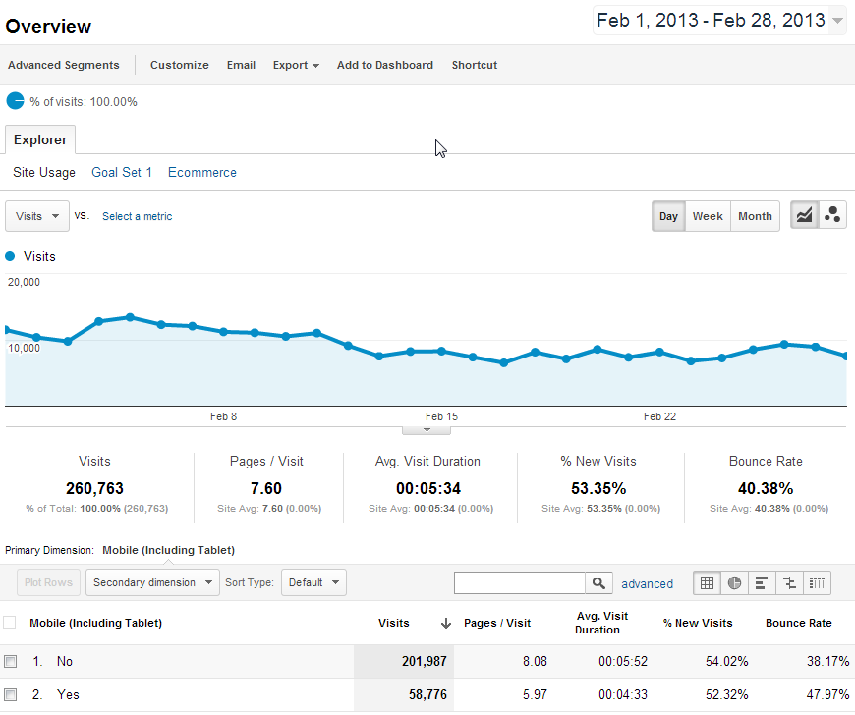
Mobile Browsers Report

Slide 33
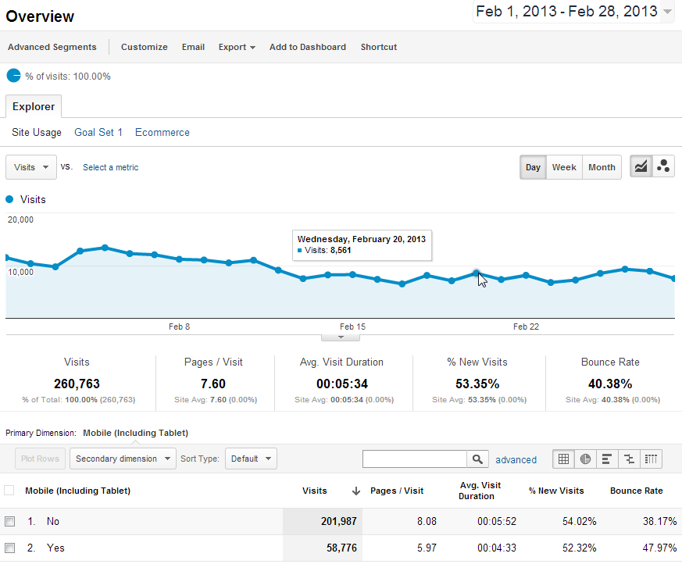
Mobile Browsers Visits Report

Slide 34
Other uses for web analytics data
Website availability and usability tracking
Track inbound links for reputation management and to prevent content theft
Determine the words and phrases visitors use to find your site

Slide 35
Engagement
Are visitors to my site interested in the content?
Indicators:
Visit Length (time on site)
Bounces / Bounce Rate
Return Visits
Content reports (page views)
Click Map data: (overlays, heat maps)

Slide 36

Bounces / Bounce Rate
Wikipedia defines Bounces:
A bounce occurs when a web site visitor only views a single page on a website, that is, the visitor leaves a site without visiting any other pages before a specified session-timeout occurs.

Slide 37
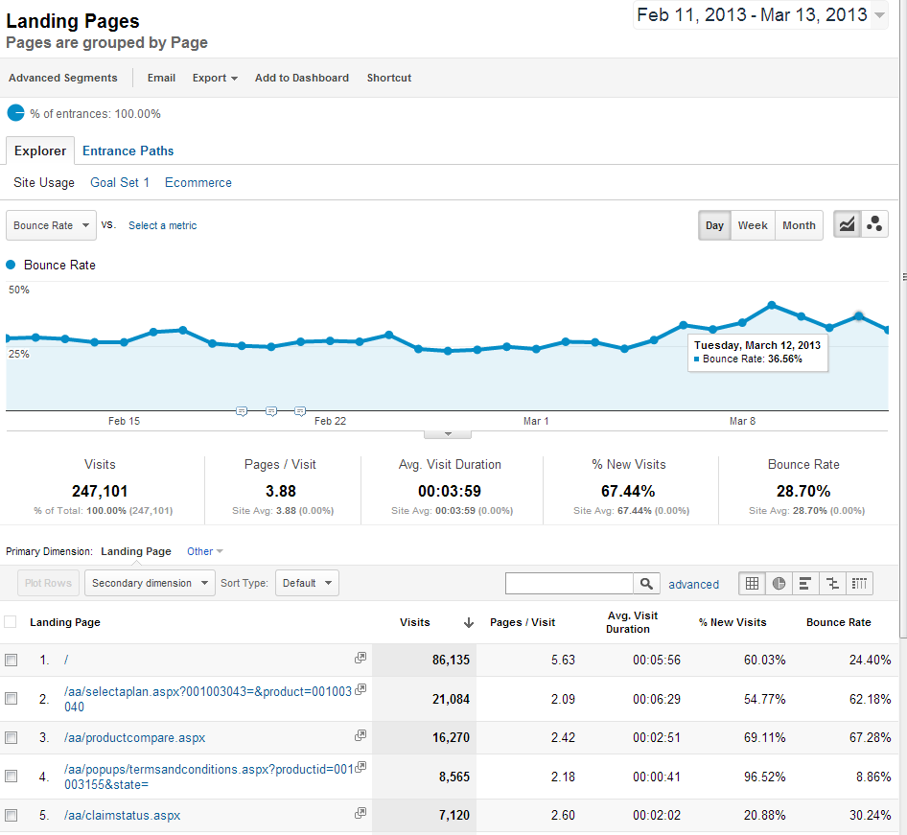

Slide 38
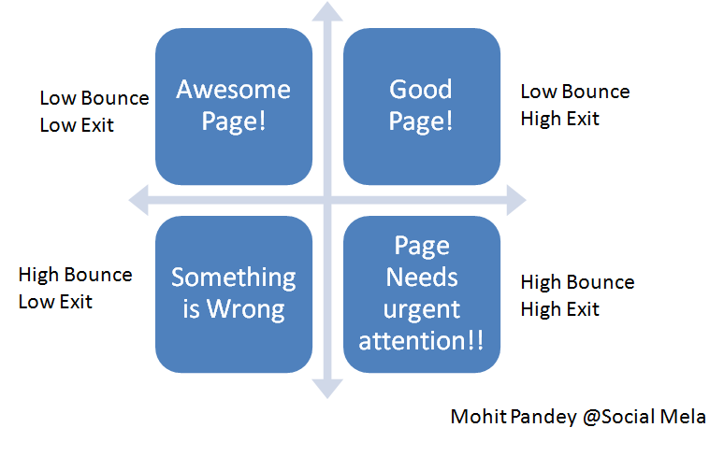
Bounce Rate “rules of thumb”
(no industry standards here!)

Slide 39
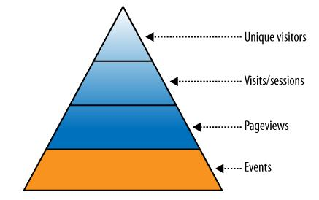
Events

Slide 40
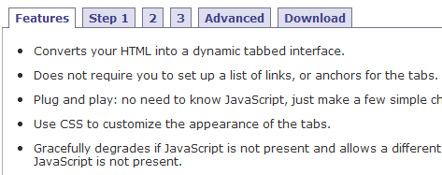
Track Page Events for insights
Clicks which occur on the same page
Downloads
Image Zoom
Content tabs

Slide 41
Conversion
A site visitor completes a ‘goal’ on your site (completes a sale, registers, subscribes, finds an article, self-support, etc.)
Sales aren’t the only conversions in the web analytics world

Slide 42
Tracking Conversion
Trends and factors which affect sales, registration, lead generation, subscription,
Many conversions are a multi-step sequence of events
Some analysts label each event, or step, in the conversion process a ‘micro conversion’

Slide 43
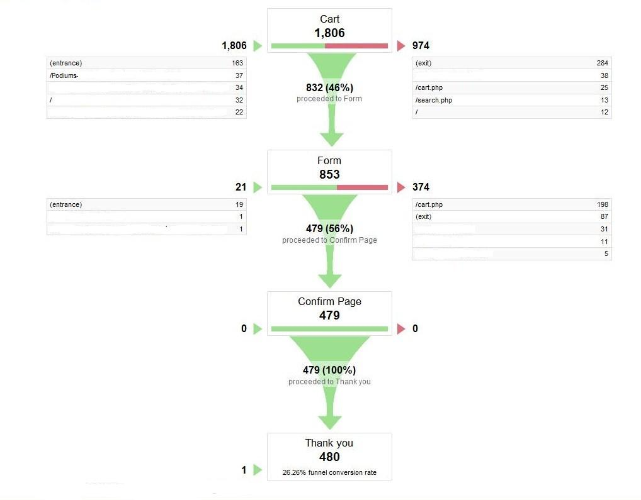
Graphic Conversion Funnel

Slide 44
Digging Deeper
Scenario Analysis reports may contain surprise insights into visitor behavior – monitor unexpected entry and exit pages
“Path” Reports provide insight when visitor behavior isn’t recorded in a Scenario Analysis/funnel report

Slide 45
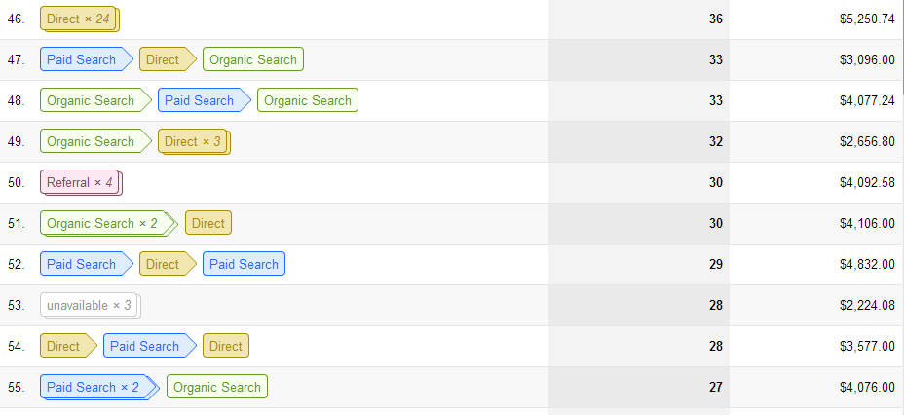
Multi-Channel Funnels
(path to conversion)
Conversions > Multi-Channel Funnels > Top Conversion Paths

Slide 46
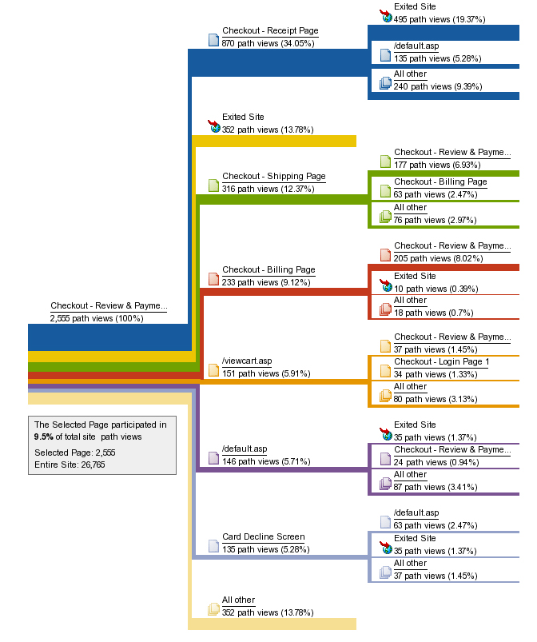
Path (Flow) reports
Visualize planned and unexpected paths taken by visitors from selected pages
In Google Analytics, use
Pages >Navigation Summary

Slide 47
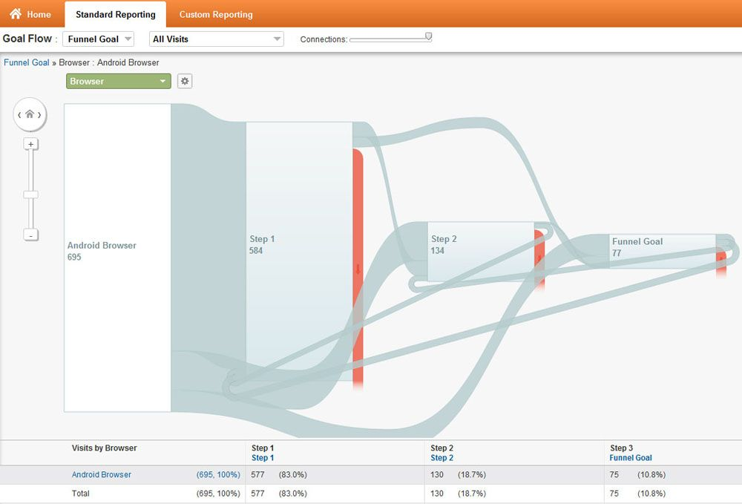

Slide 48
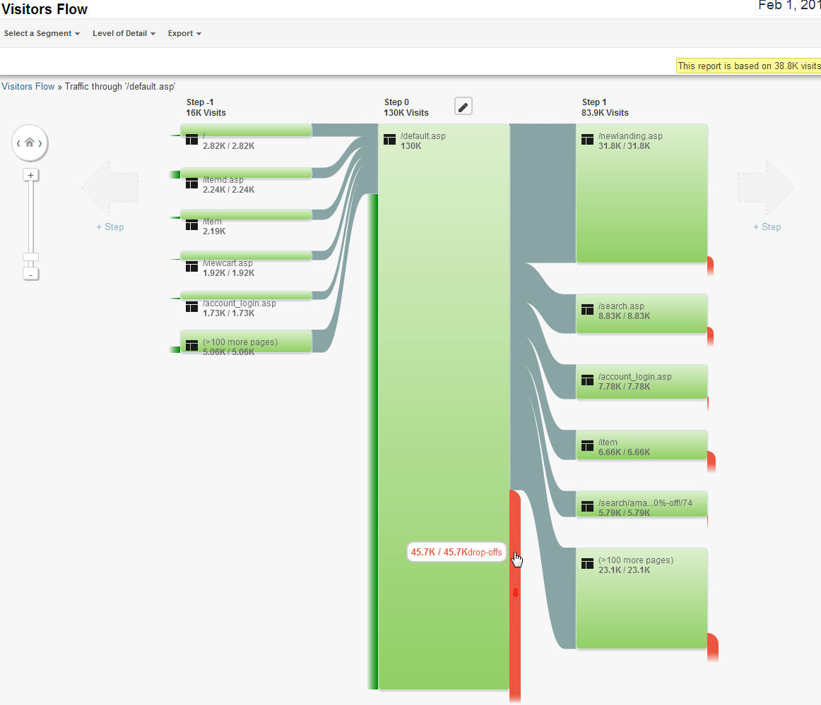
Orange
denotes Fallout

Slide 49
Combine Dimensions & Metrics to find insights
So far we’ve only used ‘standalone’ building block metrics
Next we’ll combine these building block metrics to get insight into visitor behavior

Slide 50
Custom Reports
Google Analytics allows users to create Custom Reports using dimensions and metrics to create useful non-standard reports
Previously this capability was available only in enterprise-level (paid) web analytics products

Slide 51
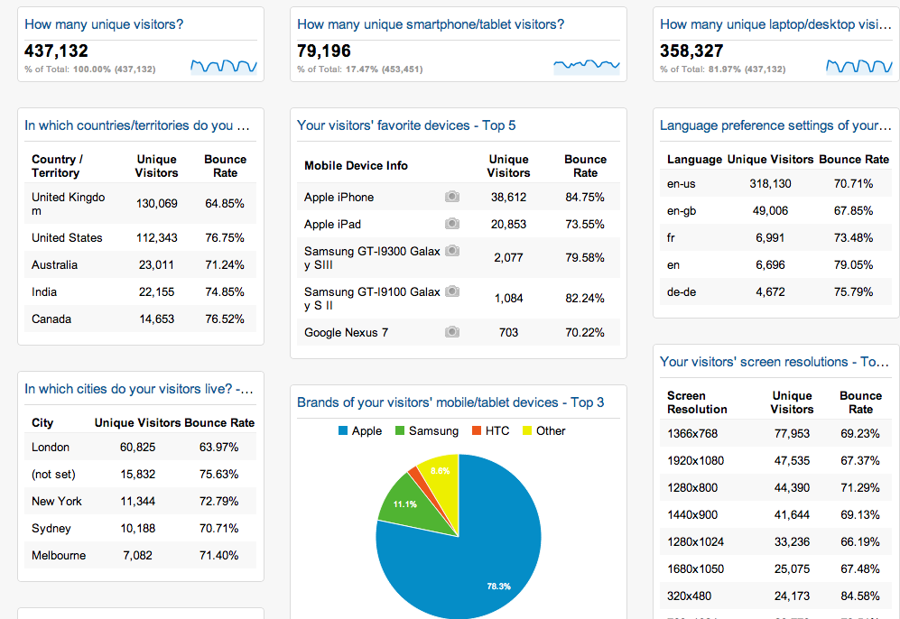
Dashboards
Dashboards summarize your most important reports on a single sheet

Slide 52
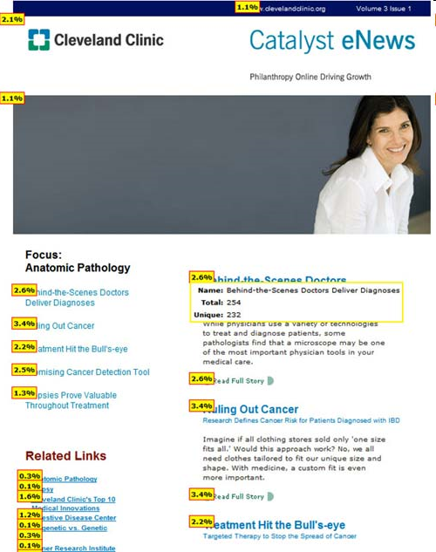
Click Maps
(overlays)
Click Density report provide a visual display of clicks / link popularity

Slide 53
Report Delivery
web browser access (standard method)
email delivery of dashboards, alerts,
SMS text messages (usually alerts)
mobile browser access (smartphones, iPad, etc.)
Plugins to client software such as Excel
APIs allow integration with other applications

Slide 54


Data Export
All web analytics tools offer a way to get data out of the system in one format or another, which will allow you to manipulate the data as needed.

Slide 55
Data Validation
If available, attempt to validate and augment your web analytics data with internal systems data
Accounting and fulfillment system (ERP)
CRM systems data
Data warehouse

Slide 56
Augment Web Analytics Reports
Customer Flow
  Can you join web analytics visitor data with data from a downstream system to determine new or existing customers?
Are online visitor actions cost-effective or money saving?
Web self-service vs. phone center costs

Slide 57
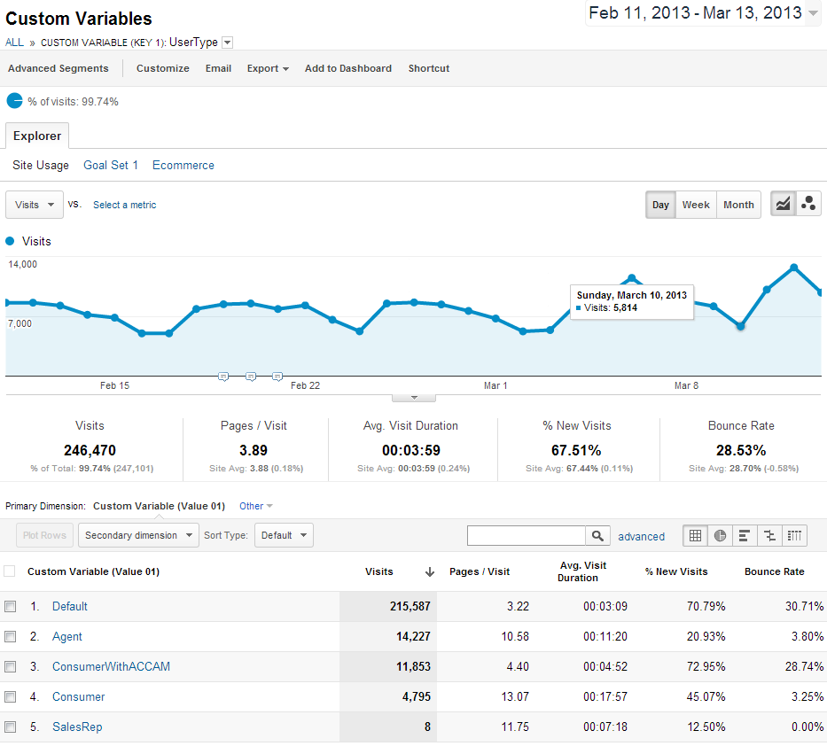

Slide 58
Web Analytics Careers
It’s a Hot Market !
Do you like…
  playing detective / troubleshooting?
  unraveling “mysteries”?
  hypotheses/theories and proofs?
  testing and quality assurance?
  comfortable with imperfect data,
  and even imperfect answers?

Slide 59
Web Analytics Careers
Qualifications (among others…)
Programmer / Analyst
Business Process
Data Governance
Change Control
Database / DBA
Data Elements
Web development
  html
  javascript
testing / troubleshooting
quality assurance
data cleanup

Slide 60
Conclusion
Question and Answer
Clarifications
Google Analytics quick walkthrough

Slide 61
References
Web Analytics 2.0 by A. Kaushik
Web Analytics Demystified
anything by Eric Peterson, Jim Sterne, Jim Novo
Blogs and whitepapers

Slide 62
Thank you! mitchell@onceinaweb.com

