Slide 1
Web Analytics
Mitchell Teixeira
mitchell@onceinaweb.com

Slide 2
Background about me
mainframe computer operations (1988)
Web Developer since late 1996
B2B - Launched first website for Overnite Transportation (now UPS Freight) in 1997
B2C – moved to multi-channel ecommerce in 2000 began ‘serious’ Webtrends implementations in 2005
2007 – present: freelance web development and web analytics implementation
2016 – joined Active Network as Sr. tagging specialist

Slide 3
Perspective (disclaimer?)
Web analytics topics can get into the weeds on technical details really fast – this presentation is an attempt to offer a high-level view about web analytics concepts, data gathering, reporting and usage
My primary perspective is from a Web Analytics implementation point of view (I’m not a marketer)

Slide 4
Objectives
What is Web Analytics
Concepts
Web Analytics career opportunities
Live analytics tool walkthrough (time permitting)
Questions

Slide 5
What is Web Analytics?
According to the
Digital Analytics Association
(DAA)…
Web Analytics is the measurement, collection, analysis and reporting of Internet data for the purposes of understanding and optimizing Web usage.

Slide 6
Primitive origins generate a revolution
Web Server Logs – the old fashioned way
Custom Tagging and site prep
Marketers demand insightful reports and analysis capabilities with visualizations

Slide 7
Web Analytics software has evolved into a data warehouse
Gather raw web usage data
Analyze using business rules (standard and industry-specific)
Provide tools to view, visualize and export reports for further analysis and to join with data from other systems

Slide 8
Web Analytics attempts to answer the typical questions
Who
What
When
Where
Why
How

Slide 9
Web Analytics attempts to answer the typical questions
Who (location, demographics)
What (page views, events)
When (time & date / seasonality)
Where (location, network)
Why (events, clickpath, pages viewed)
How (device type, screen size, network)

Slide 10
Wealth of data elements
As web sites are used each day, a large amount of raw data is generated
This data can be analyzed to learn more about your customers and can allow you to serve them better and capitalize on opportunities and discoveries

Slide 11
Standard data
Pages requests (clicks and links)
Client and network data

Slide 12
Custom Tracking
What is important to the customer / site owner?
At first, most want to “track everything”

Slide 13
Let’s Track Everything (?)

Slide 14
Questions and Decisions
What can we quantify?
What can we action upon?
Do we have resources to respond/change/modify
What is really important to our mission?

Slide 15
Version A or Version B
Track less, to get started

Slide 16
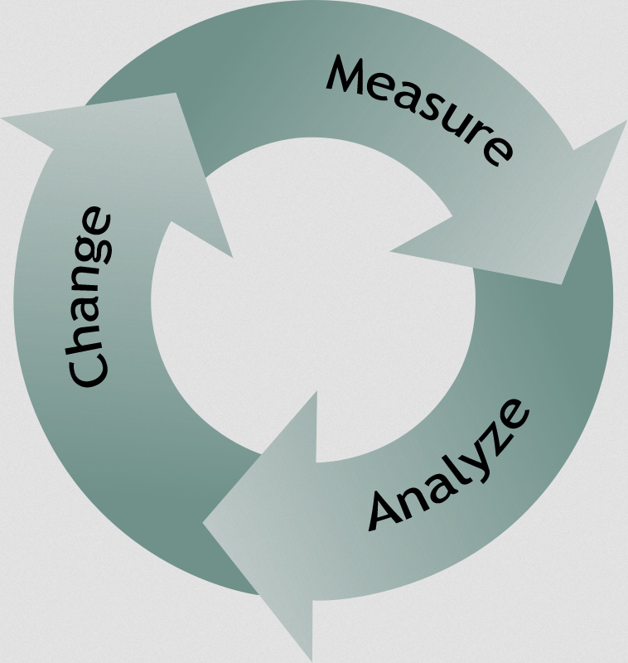
Web Analytics Cycle

Slide 17
What will we count / track?
What will your site visitors do on your site that is valuable to your mission?
Browse / learn
Purchase
Register
Contact
Track a shipment, order, request, etc.
Request a quote
Start a free trial

Slide 18
Define Metrics for your web venture
Business website?
Government agency site?
Non-profit ?
Hobby / leisure ?
What actions do you want your visitors to take on your site?
Define measurable goals for your website
The metrics most important to your business become your Key Performance Indicators (KPIs)

Slide 19
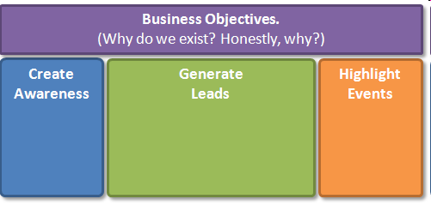
Defining Metrics (getting started)

Slide 20
Defining Goals we can measure

Slide 21
Initial Implementation
Register for Google Analytics
Create a web “property” for the site
Download simple “tag”
Install tag on every page of the site

Slide 22
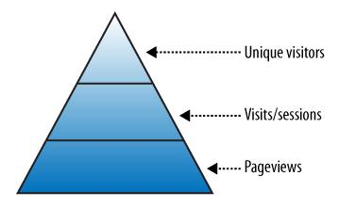
Web Analytics Reports
“Big 3” (building blocks)

Slide 23
Page Views
Count of how many times a page was accessed on your site
Aggregate count of how many times all site pages were viewed
Basically: what did visitors look at,
and how many times did they look?

Slide 24
Visits
Basically, a count of how many times the site was viewed by visitors
Another term for a visit is session. A session includes all the pages a visitor views at one sitting.
Total visits is a count of all the sessions during a given time period
Considered by many to be the most accurate measure of site utilization

Slide 25
Visitors / Unique Visitors
Sometimes simply called uniques
An attempt to quantify site visitors as individual warm bodies or pairs of eyeballs
Caveats
Technical issues may distort this count
Same person can view site from multiple computers and is counted each time
etc.

Slide 26
Sample Pages Report

Slide 27
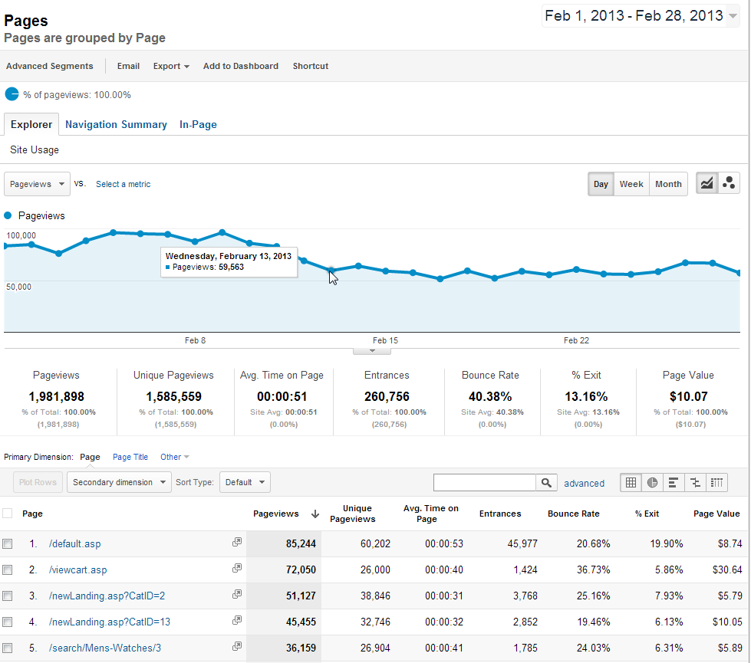

Slide 28
More reports: Traffic
Where is my site’s traffic coming from?
Direct (typed or bookmarked)
Organic search
Paid search (pay-per-click)
Links
Social networks
Other paid campaigns

Slide 29
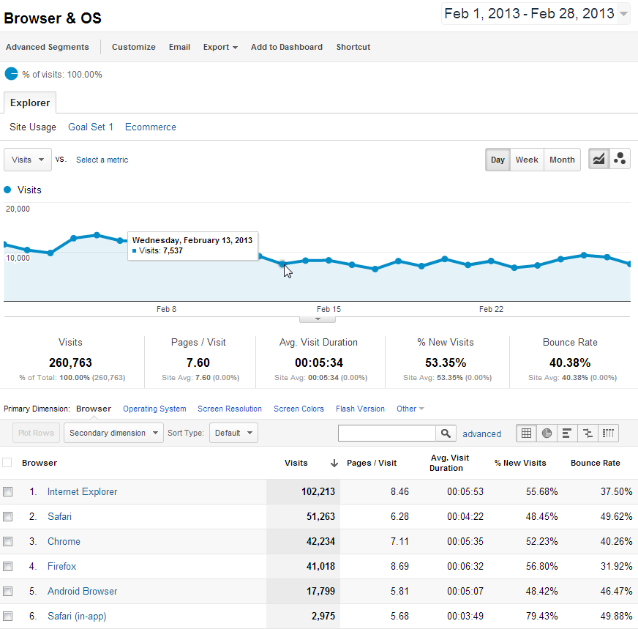
Technology (Browsers) Report

Slide 30
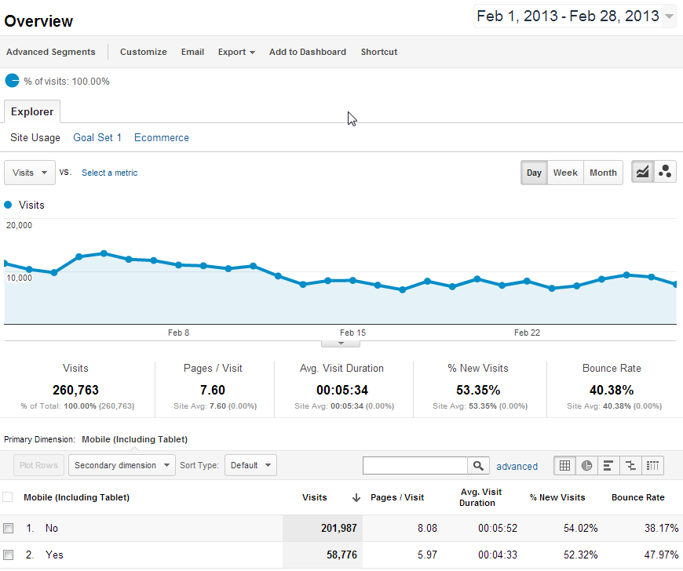
Mobile Browsers Report

Slide 31
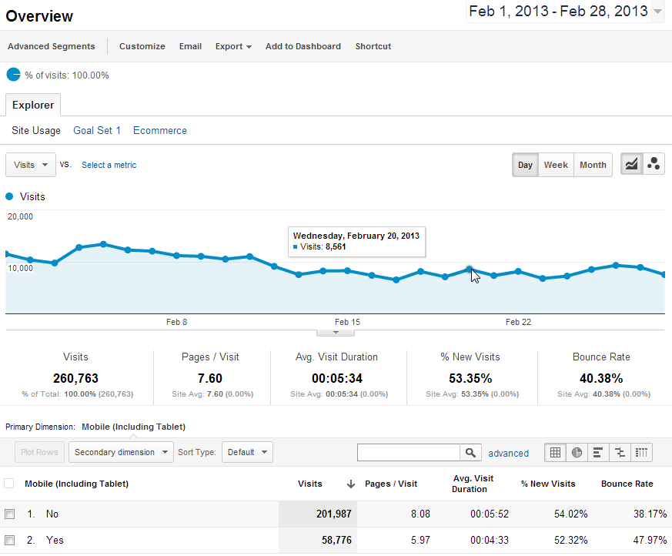
Mobile Browsers Visits Report

Slide 32
Other uses for web analytics data
Website availability and usability tracking
Track inbound links for reputation management and to prevent content theft
Determine the words and phrases visitors use to find your site

Slide 33
Engagement
Are visitors to my site interested in the content?
Indicators:
Visit Length (time on site)
Bounces / Bounce Rate
Return Visits
Content reports (page views)
Click Map data: (overlays, heat maps)

Slide 34
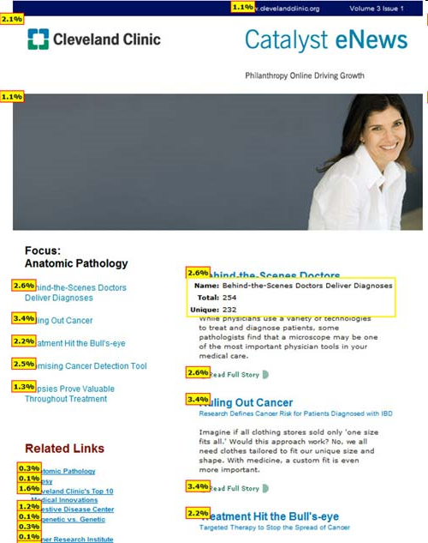
Click Maps (overlays) Click Density report provide a visual display of clicks / link popularity

Slide 35
Bounces / Bounce Rate
Wikipedia defines Bounces:
A bounce occurs when a web site visitor only views a single page on a website, that is, the visitor leaves a site without visiting any other pages before a specified session-timeout occurs.

Slide 36
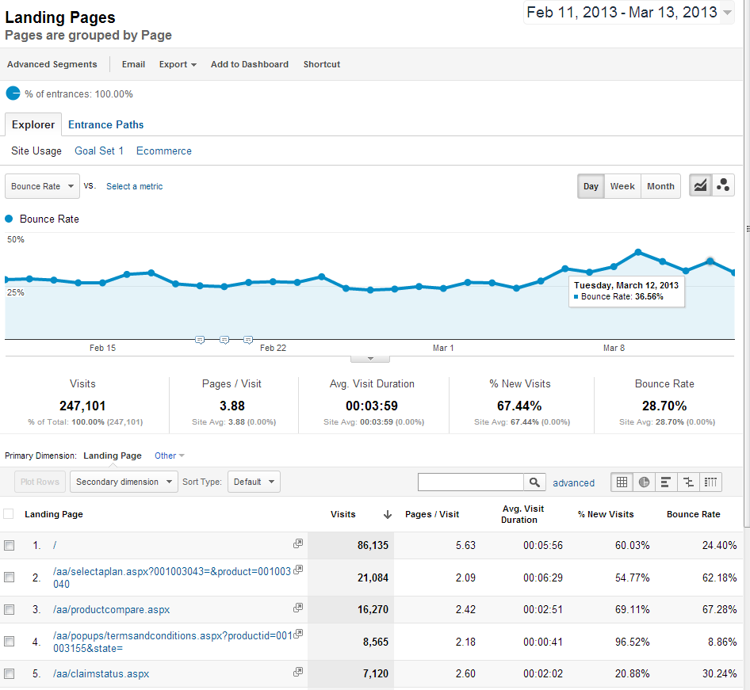

Slide 37
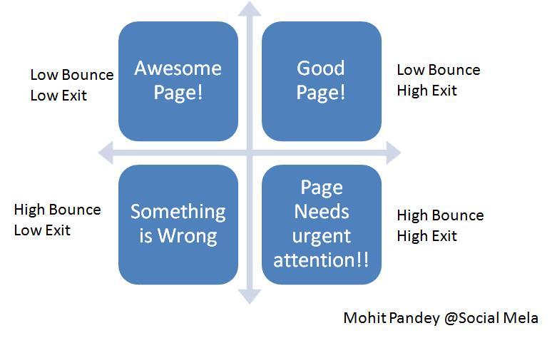
Bounce Rate “rules of thumb”
(no industry standards here!)

Slide 38
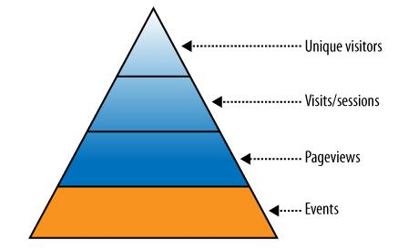
Events

Slide 39
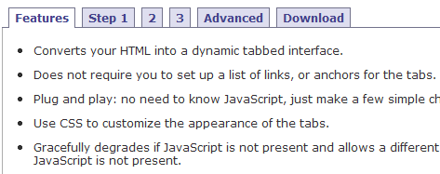
Track Page Events for insights
Clicks which occur on the same page
Downloads
Image Zoom
Content tabs

Slide 40
Conversion
A site visitor completes a ‘goal’ on your site (completes a sale, registers, subscribes, finds an article, self-support, etc.)
Sales aren’t the only conversions in the web analytics world

Slide 41
Tracking Conversion
Trends and factors which affect sales, registration, lead generation, subscription,
Many conversions are a multi-step sequence of events
Some analysts label each event, or step, in the conversion process a ‘micro conversion’

Slide 42
Graphic Conversion Funnel

Slide 43
Digging Deeper
Scenario Analysis reports may contain surprise insights into visitor behavior – monitor unexpected entry and exit pages
“Path” Reports provide insight when visitor behavior isn’t recorded in a Scenario Analysis/funnel report

Slide 44
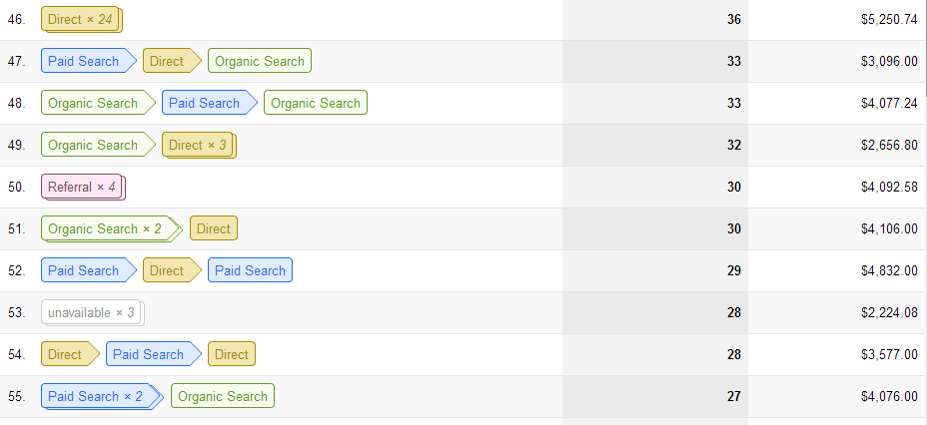
Multi-Channel Funnels (path to conversion) Conversions > Multi-Channel Funnels > Top Conversion Paths

Slide 45
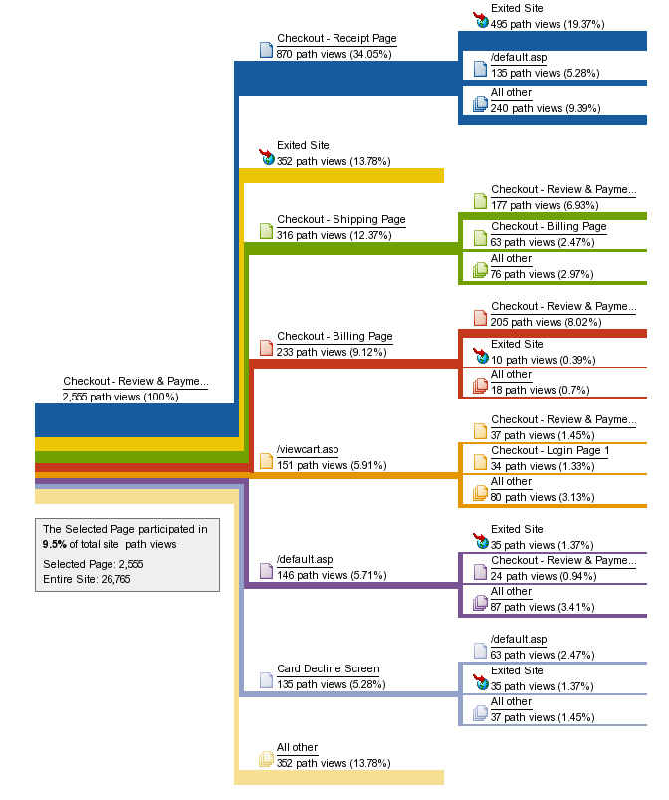
Path (Flow) reports
Visualize planned and unexpected paths taken by visitors from selected pages
In Google Analytics, use
Pages >Navigation Summary

Slide 46
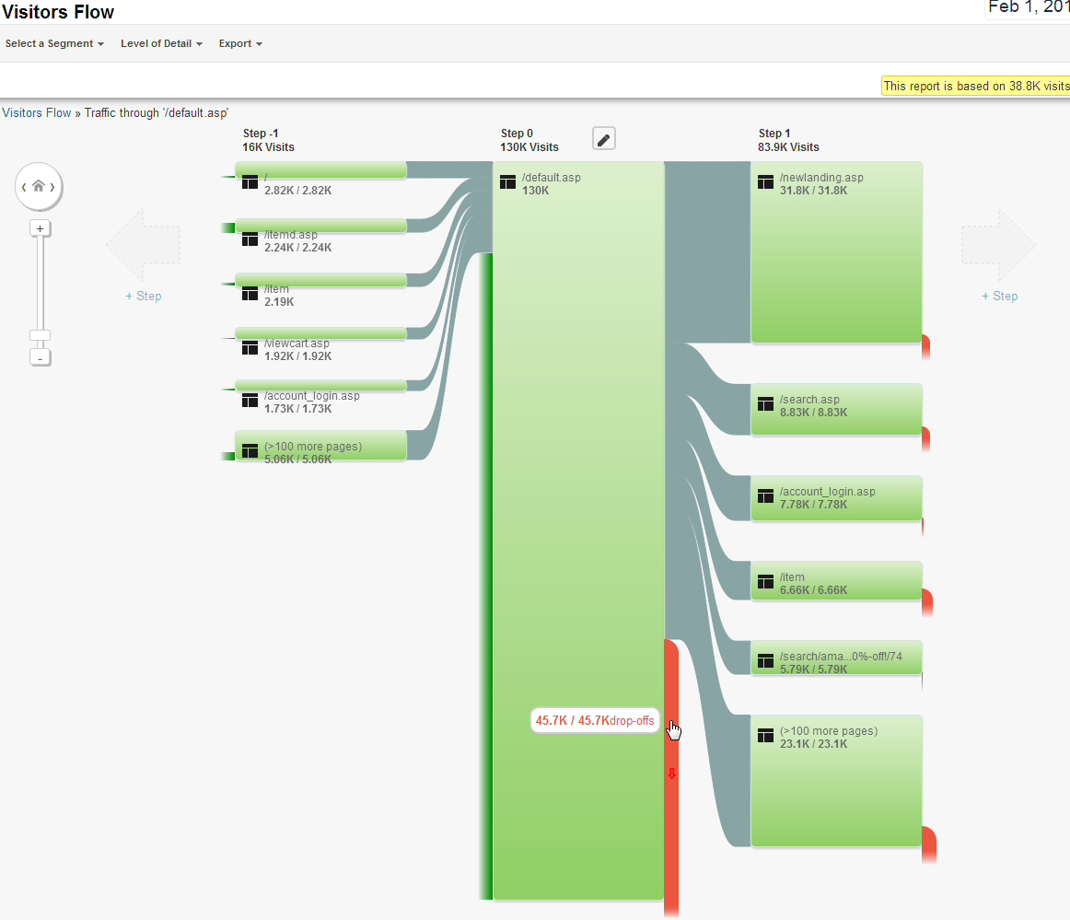
Orange
denotes Fallout

Slide 47
Combine Dimensions & Metrics to find insights
So far we’ve only used ‘standalone’ building block metrics
Next we’ll combine these building block metrics to get insight into visitor behavior

Slide 48
Custom Reports
Google Analytics allows users to create Custom Reports using dimensions and metrics to create useful non-standard reports
Previously this capability was available only in enterprise-level (paid) web analytics products

Slide 49
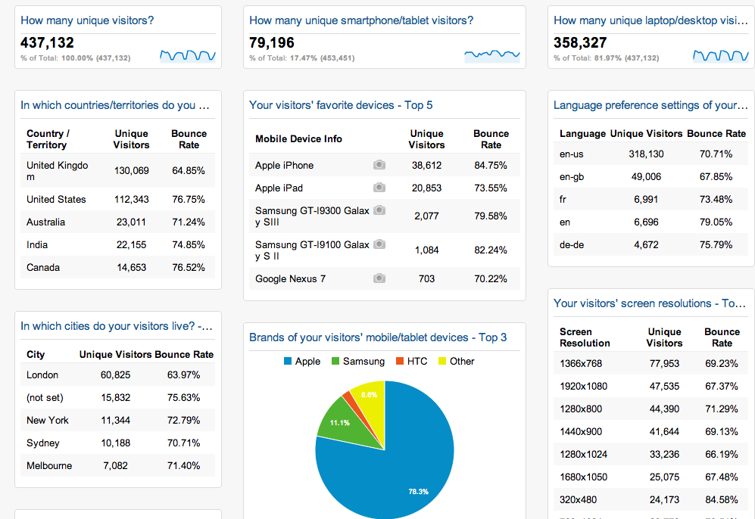
Dashboards Dashboards summarize your most important reports on a single sheet

Slide 50
Report Delivery
web browser access (standard method)
email delivery of dashboards, alerts,
SMS text messages (usually alerts)
mobile browser access (smartphones, iPad, etc.)
Plugins to client software such as Excel
APIs allow integration with other applications

Slide 51
Data Export
All web analytics tools offer a way to get data out of the system in one format or another, which will allow you to manipulate the data as needed.

Slide 52
Data Validation
If available, attempt to validate and augment your web analytics data with internal systems data
Accounting and fulfillment system (ERP)
CRM systems data
Data warehouse

Slide 53
Augment Web Analytics Reports
Customer Flow
Can you join web analytics visitor data with data from a downstream system to determine new or existing customers?
Are online visitor actions cost-effective or money saving?
Web self-service vs. phone center costs

Slide 54
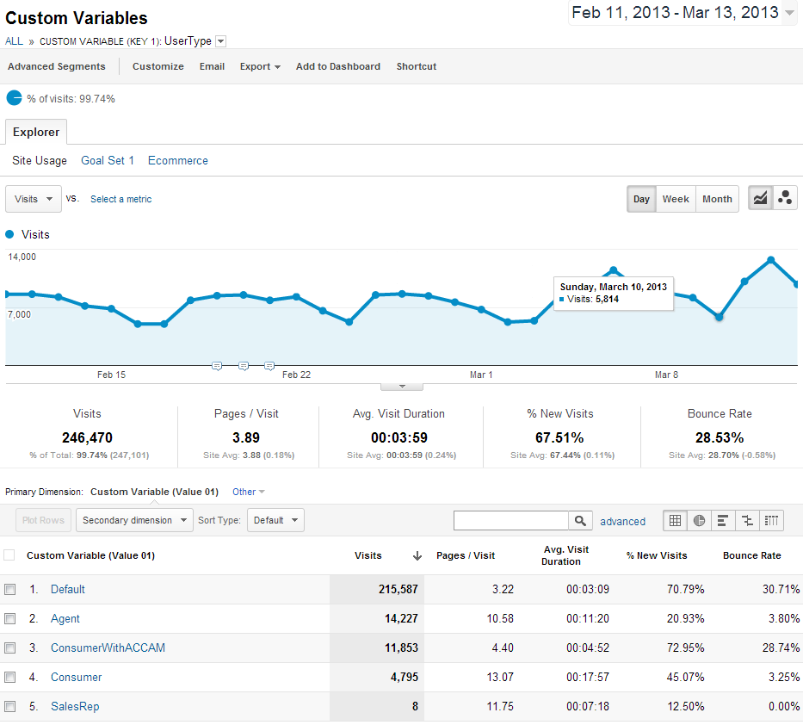

Slide 55
Web Analytics Careers
It’s a Hot Market !
Do you like…
playing detective / troubleshooting?
unraveling “mysteries”
hypotheses/theories and proofs
testing and quality assurance
happy with imperfect data and even impefect answers?

Slide 56
Web Analytics Careers
Qualifications (among others…)
Programmer / Analyst
Business Process
Data Governance
Change Control
Database / DBA
Data Elements
Web development
html
javascript
testing / troubleshooting
quality assurance
data cleanup

Slide 57
Conclusion
Question and Answer
Clarifications
Google Analytics quick walkthrough

Slide 58
References
Web Analytics 2.0 by A. Kaushik
Web Analytics Demystified
anything by Eric Peterson, Jim Sterne, Jim Novo
Blogs and whitepapers

Slide 59
Thank you! mitchell@onceinaweb.com

