Slide 1
Web Analytics Overview
Mitchell Teixeira
mitchell@onceinaweb.com

Slide 2

Background about me
mainframe computer operations roots (1988)
Web Developer since late 1996
B2B - Launched first website for Overnite Transportation (now UPS Freight) in 1997
B2C – moved to multi-channel ecommerce in 2000 began ‘serious’ Webtrends implementations in 2005
2007 – present: freelance web development and web analytics implementation

Slide 3
Perspective
(disclaimer?)
This presentation is from a Web Analytics implementation viewpoint and will touch upon some marketing terms
Web analytics topics can get into the weeds on technical details really fast – this presentation is an attempt to offer a high-level view about web analytics concepts, data gathering, reporting and usage

Slide 4
Objectives
What is Web Analytics
Concepts and Sample reports
How to get started
Live analytics tool walkthrough (time permitting)
Questions

Slide 5
What is Web Analytics?
According to the
  Web Analytics Association (WAA)…
The Official Definition of Web Analytics:
Web Analytics is the measurement, collection, analysis and reporting of Internet data for the purposes of understanding and optimizing Web usage.

Slide 6
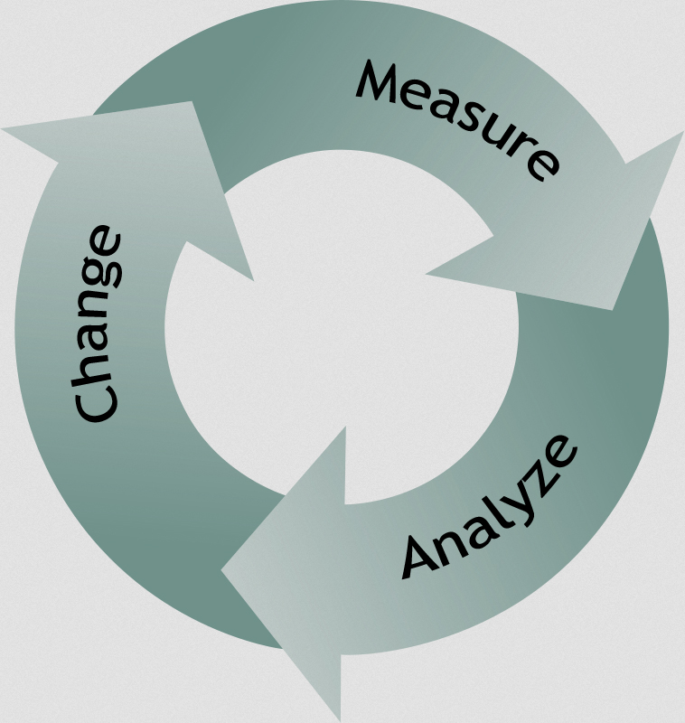
Web Analytics Cycle

Slide 7
Great News: You have a Web Site!
So what!
Site owners have questions…
Is anyone using the site?
Is it running?
Is it effective? (effective at what!?)
????? (What else can you think of?)
Web analytics can answer these questions and more!

Slide 8
Define Metrics for your web venture
Business website?
Government agency site?
Non-profit ?
Hobby / leisure ?
What actions do you want your visitors to take on your site?
Define measurable goals for your website
The metrics most important to your business become your Key Performance Indicators (KPIs)

Slide 9
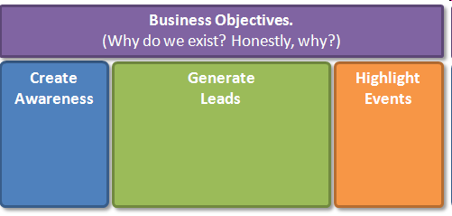
Defining Metrics
(getting started)

Slide 10
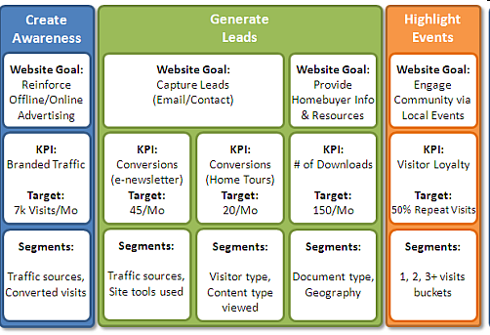
Defining Goals we can measure

Slide 11
Select a tool
Free tools
Paid tools
Hosted tools
Self Hosted tools
  (if privacy or data sharing is an issue)

Slide 12


Paid tools
Big 3 vendors
Coremetrics (IBM)
Omniture (Adobe)
Webtrends (pioneer W.A. package)
Unica (IBM) (high end)
ClickTracks
dozens of other hosted products

Slide 13
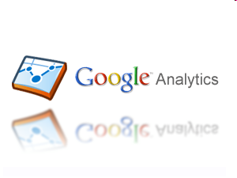

Free Tools
Google Analytics (the game changer since 2005)
Piwik (open source alternative, but self-hosted)
Pinterest Analytics (new since March 2013!)
Many others (see wikipedia)

Slide 14
Self-Hosted vs. Hosted
Hosted = software as a service (SaaS)
Google Analytics, Yahoo Analytics and all ‘paid’ services
No hardware investment (cap. exp.)
Self-hosted
Run the W.A. software in your data center
Logfiles or data collection setup

Slide 15
Initial Implementation
Install simple tags(s)
Usually a JavaScript tag which must be included on every page of the site
Logfiles: ensure logfiles are being created on the web server and contain the needed elements
Either way, more tagging/setup remains if specific goals and ecommerce data are to be captured and reported

Slide 16
The simple JavaScript code block
<script type="text/javascript">
var _gaq = _gaq || [];
_gaq.push(['_setAccount', 'UA-999999-99']);
_gaq.push(['_trackPageview']);
(function() {
var ga = document.createElement('script');
ga.src = ('http://www.google-analytics.com/ga.js');
ga.setAttribute('async', 'true');
document.documentElement.firstChild.appendChild(ga);
})();
</script>

Slide 17
Web Analytics Reports
“Big 3” (building blocks)
Visits
Visitors (uniques)
Page Views

Slide 18
Visits
Basically, a count of how many times the site was viewed by visitors
Another term for a visit is session. A session includes all the pages a visitor views at one sitting.
Total visits is a count of all the sessions during a given time period
Considered by many to be the most accurate measure of site utilization

Slide 19
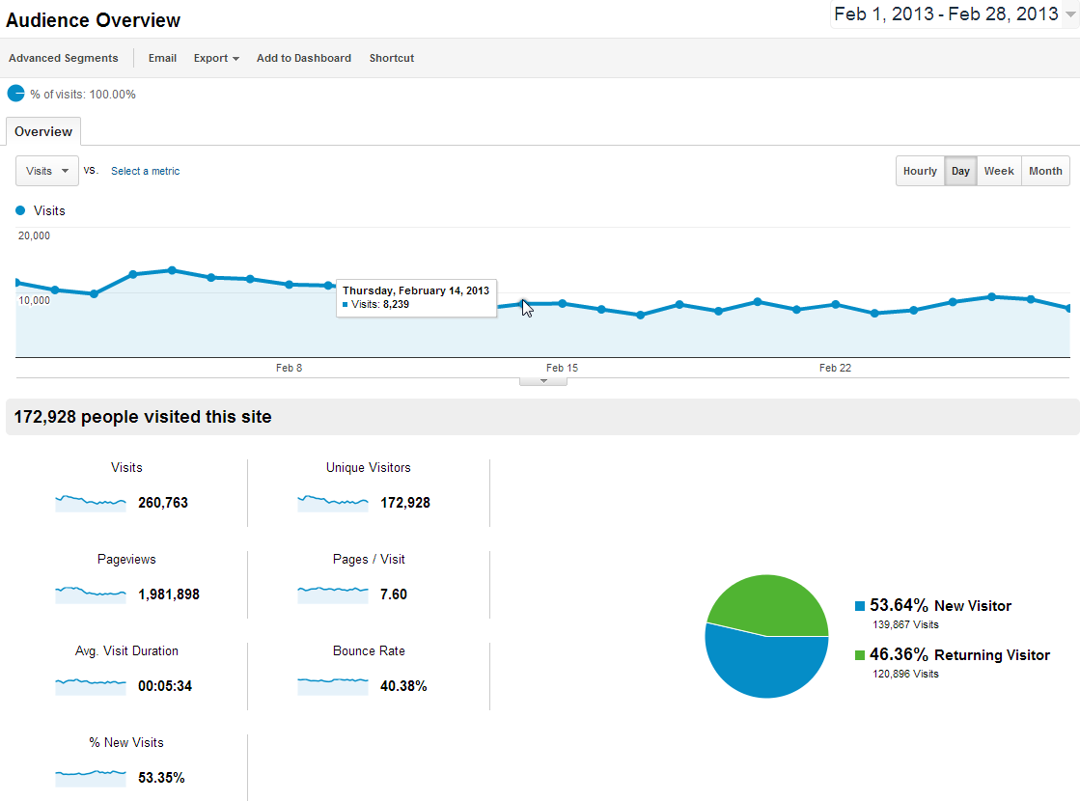

Slide 20
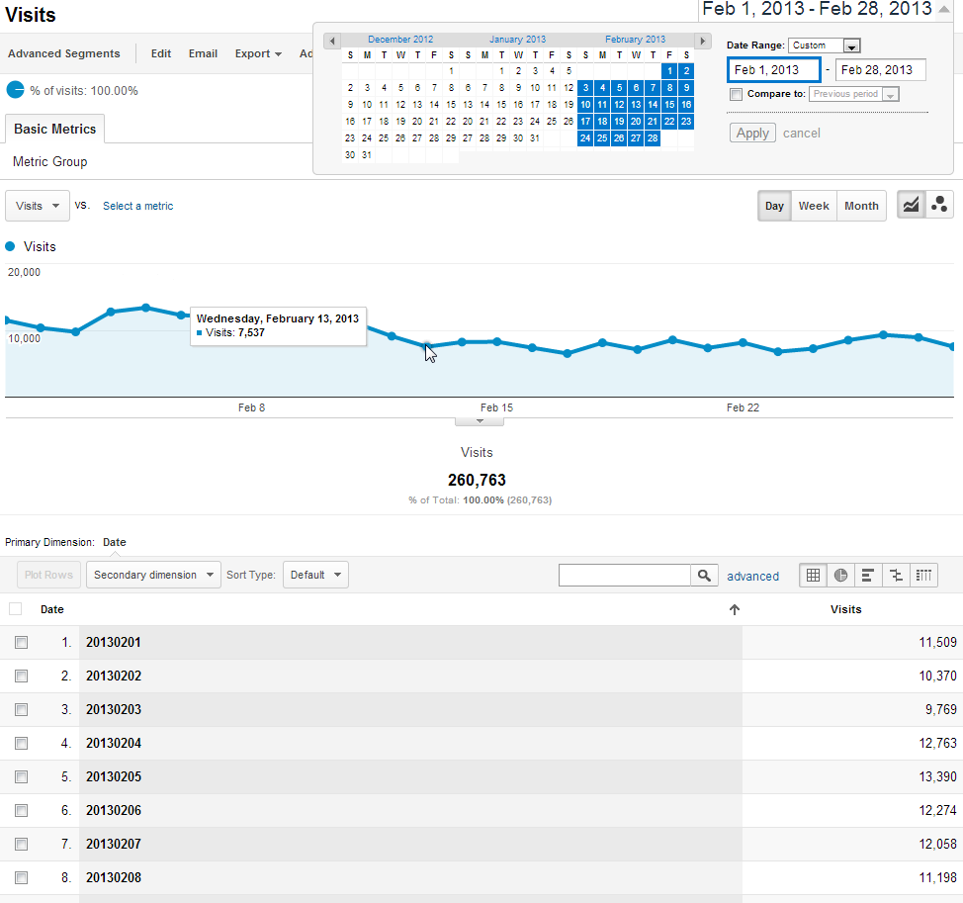

Slide 21
Visitors / Unique Visitors
Sometimes simply called uniques
An attempt to quantify site visitors as individual warm bodies or pairs of eyeballs
Caveats
  Technical issues may distort this count
  Same person can view site from multiple computers and is counted each time
  etc.

Slide 22
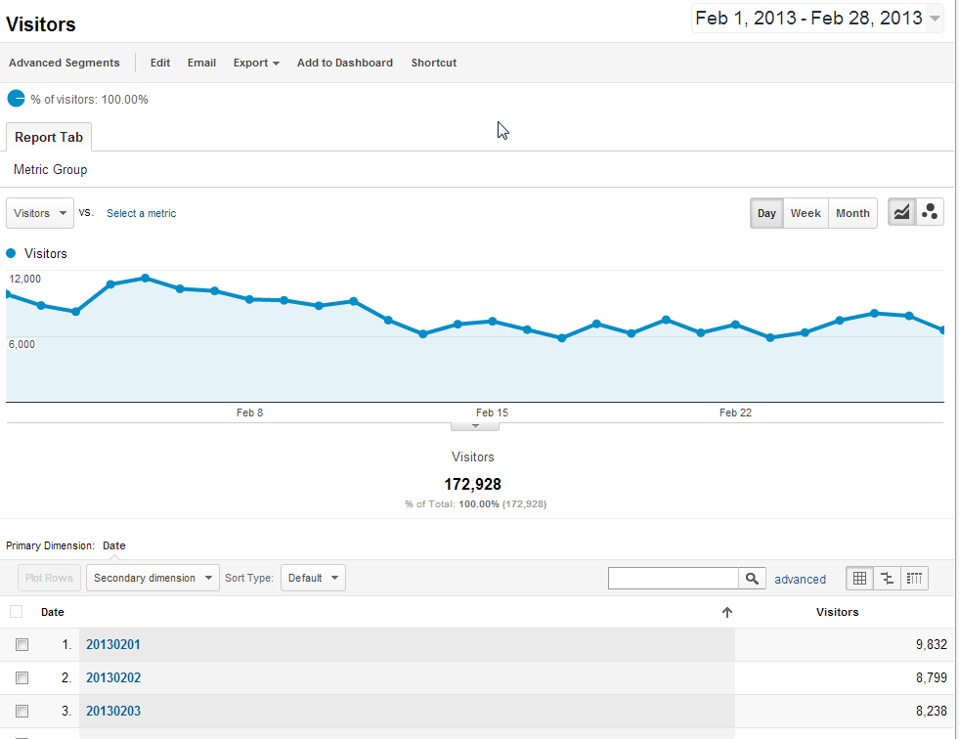

Slide 23
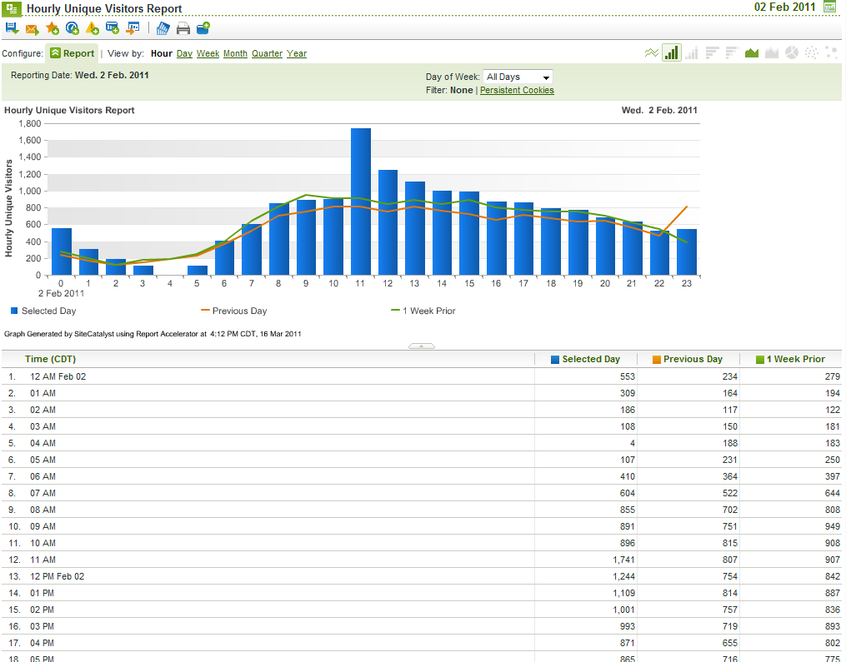
Visitors Report (visitors by hour)

Slide 24
Page Views
Count of how many times a page was accessed on your site
Aggregate count of how many times all site pages were viewed
Basically: what did visitors look at,
and how many times did they look?

Slide 25
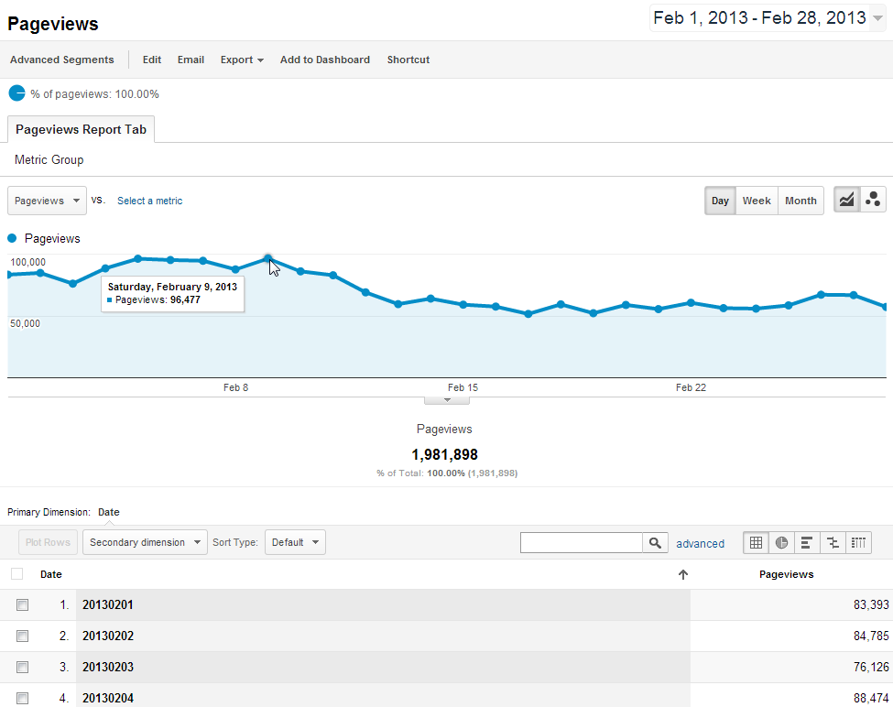

Slide 26
Combine Dimensions & Metrics to find insights
So far we’ve only used ‘standalone’ building block metrics
Next we’ll combine these building block metrics to get insight into visitor behavior

Slide 27
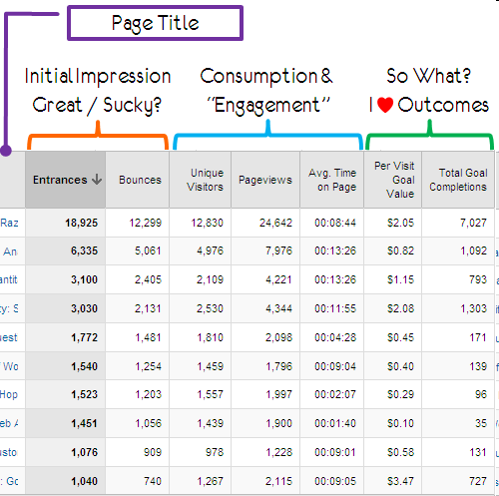
Sample Pages Report

Slide 28
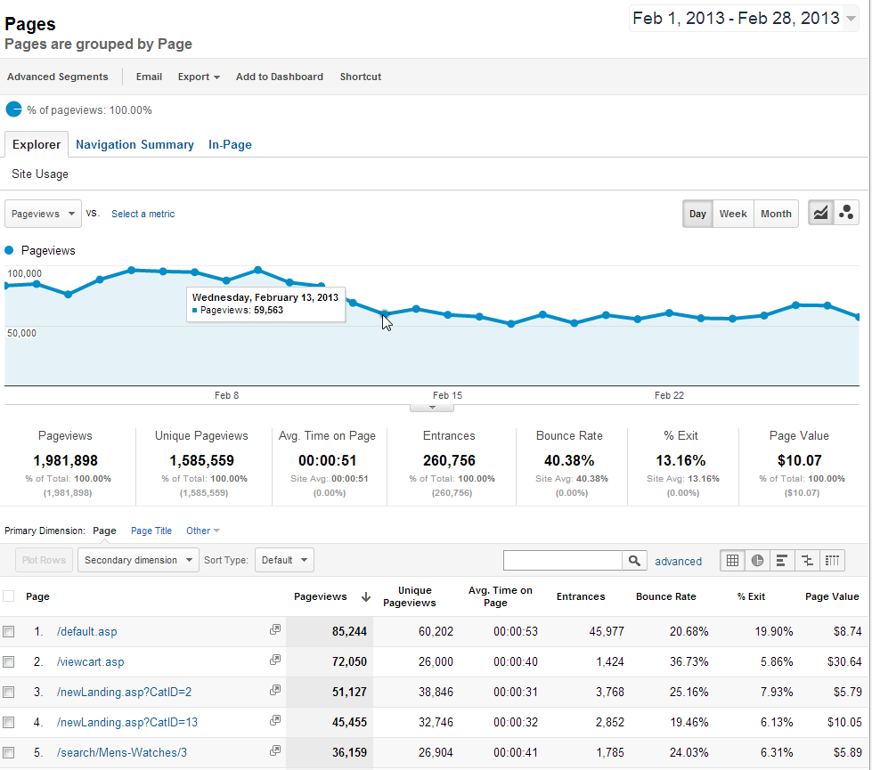

Slide 29
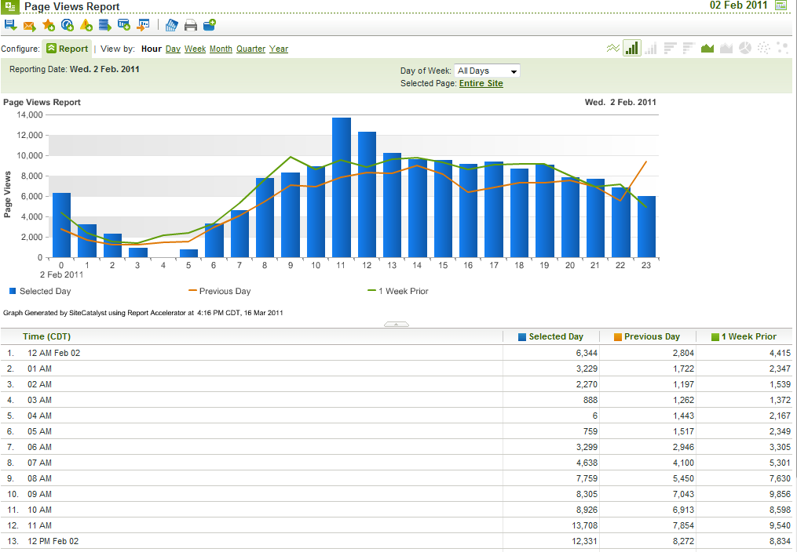
Page Views Report (by hour)

Slide 30
More reports: Traffic
Where is my site’s traffic coming from?
  Direct (typed or bookmarked)
  Organic search
  Paid search (pay-per-click)
  Links
  Social networks
  Other paid campaigns

Slide 31
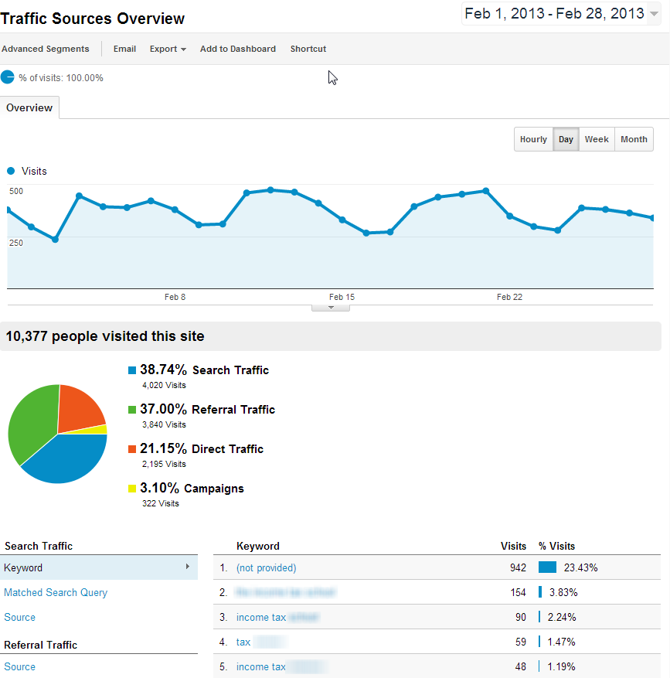

Slide 32
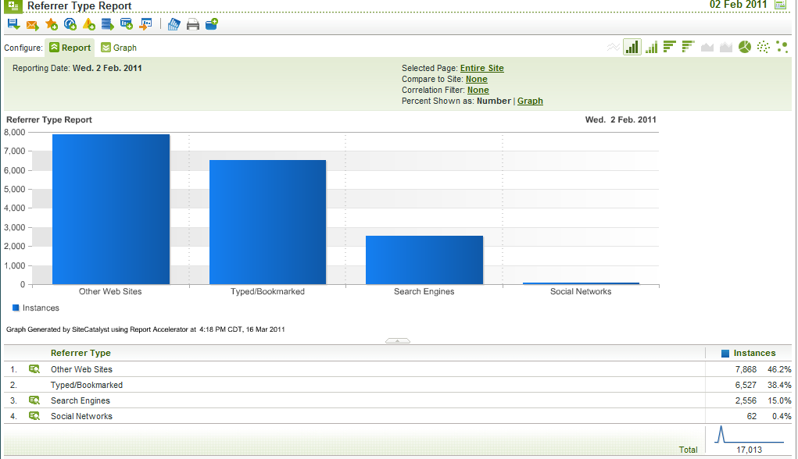
Sample Traffic Summary Report

Slide 33
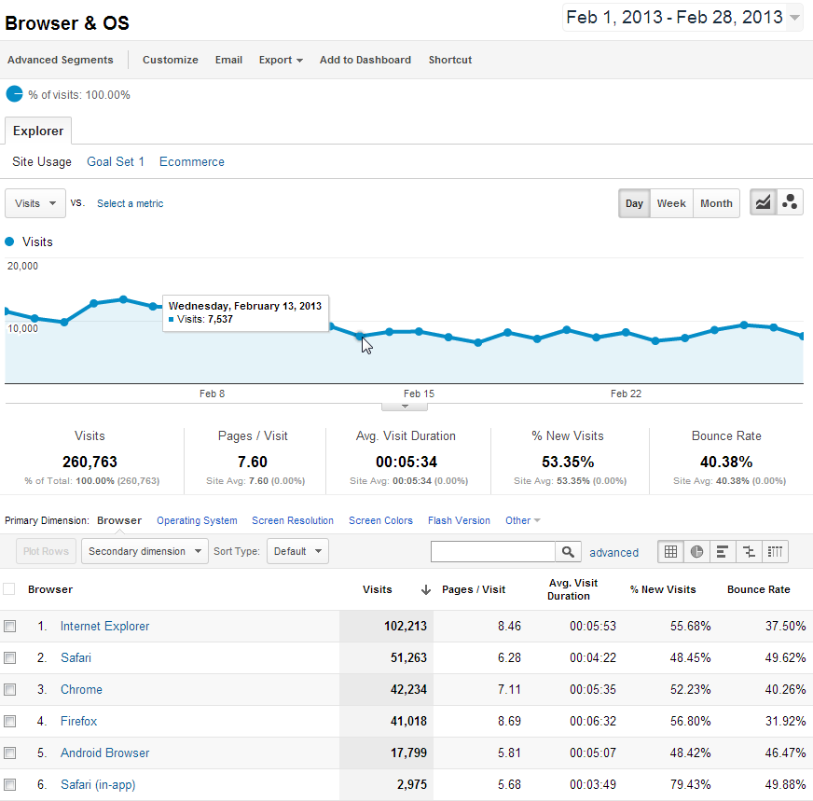
Technology (Browsers) Report

Slide 34
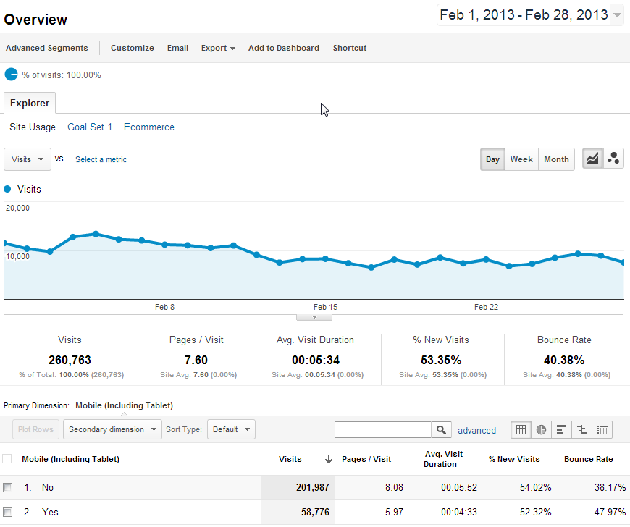
Mobile Browsers Report

Slide 35
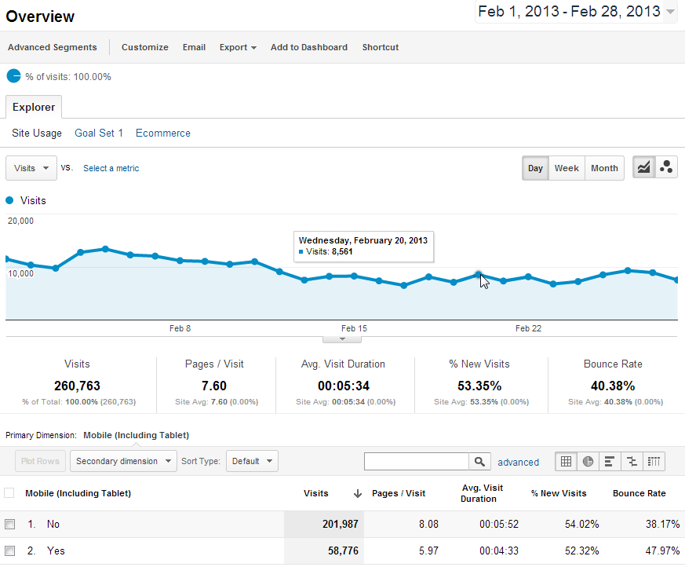
Mobile Browsers Visits Report

Slide 36
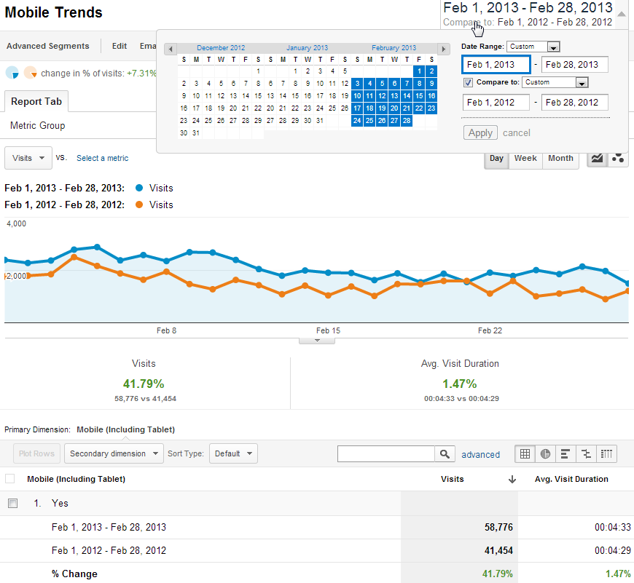
Mobile Usage year-over-year (Custom Report)

Slide 37
Other uses for web analytics data
Website availability and usability tracking
Track inbound links for reputation management and to prevent content theft
Determine the words and phrases visitors use to find your site

Slide 38
Engagement
Are visitors to my site interested in the content?
Indicators:
Visit Length (time on site)
Bounces / Bounce Rate
Return Visits
Content reports (page views)
Click Map data: (overlays, heat maps)

Slide 39
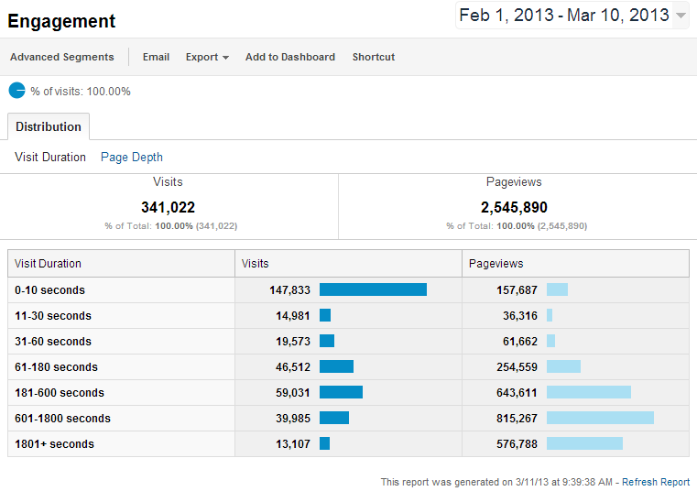
Engagement Metrics: visit duration bucketed by visits and pageviews

Slide 40
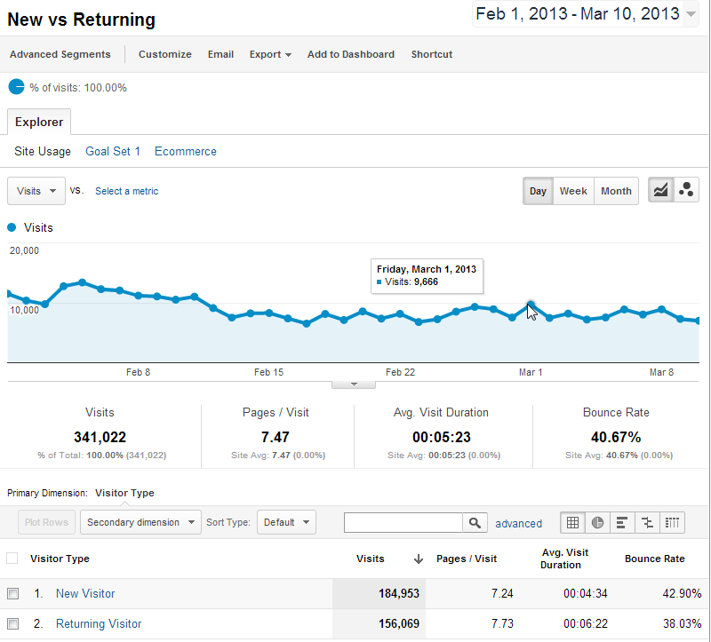

Slide 41
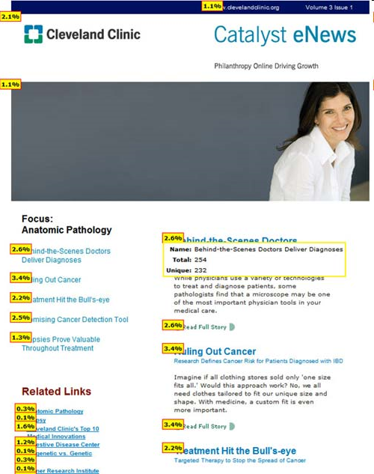
Click Maps
(overlays)
Click Density report provide a visual display of clicks / link popularity

Slide 42

Bounces / Bounce Rate
Wikipedia defines Bounces:
A bounce occurs when a web site visitor only views a single page on a website, that is, the visitor leaves a site without visiting any other pages before a specified session-timeout occurs.

Slide 43
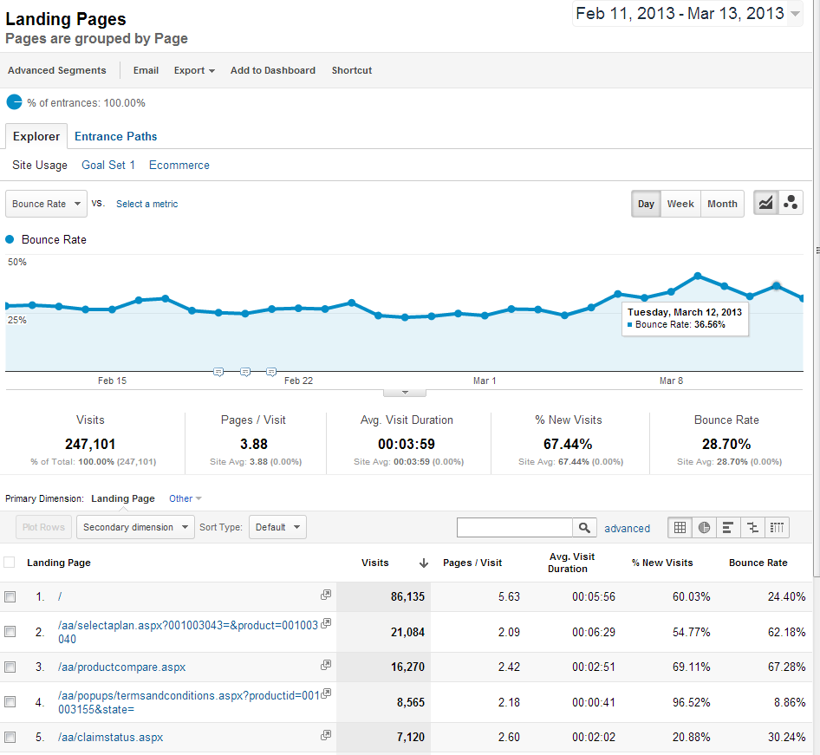

Slide 44
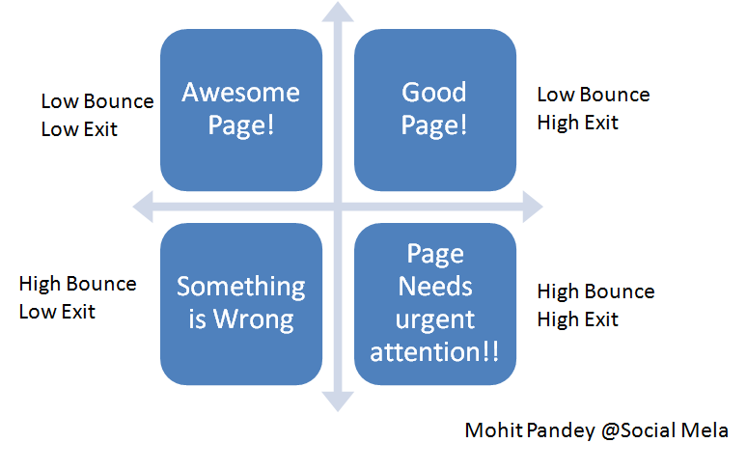
Bounce Rate “rules of thumb”
(no industry standards here!)

Slide 45
Conversion
A site visitor completes a ‘goal’ on your site (completes a sale, registers, subscribes, finds an article, self-support, etc.)
Sales aren’t the only conversions in the web analytics world

Slide 46
Tracking Conversion
Trends and factors which affect sales, registration, lead generation, subscription,
Many conversions are a multi-step sequence of events
Some analysts label each event, or step, in the conversion process a ‘micro conversion’

Slide 47
One way to do it….
Count the page views for each step in the conversion process and enter the data onto a worksheet or spreadsheet
With each step closer to the goal, you may notice the number of page views for each step decreasing
The ‘funnel’ shape emerges….

Slide 48
Rudimentary Conversion Funnel
(Page views)
Homepage 122683
Product 78394
Add to Cart 9923
Checkout 768
Confirmation 99
(notice the funnel appearance of the numbers above)

Slide 49
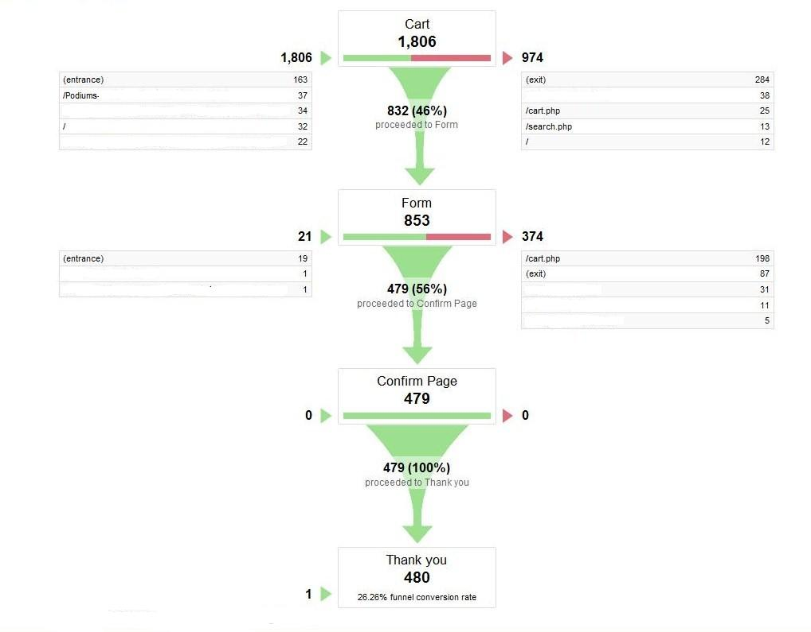
Graphic Conversion Funnel

Slide 50
Digging Deeper
Scenario Analysis reports may contain surprise insights into visitor behavior – monitor unexpected entry and exit pages
“Path” Reports provide insight when visitor behavior isn’t recorded in a Scenario Analysis/funnel report

Slide 51
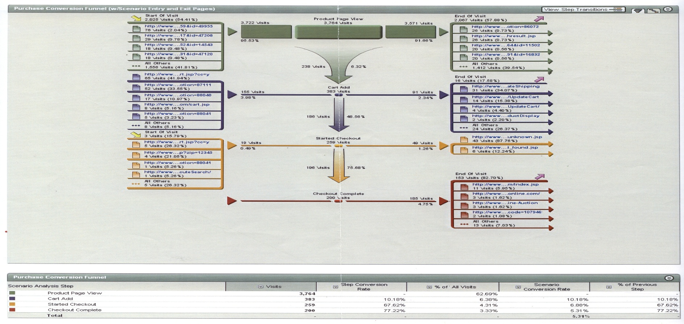
Scenario Analysis
Webtrends Scenario Analysis
(butterfly report)

Slide 52
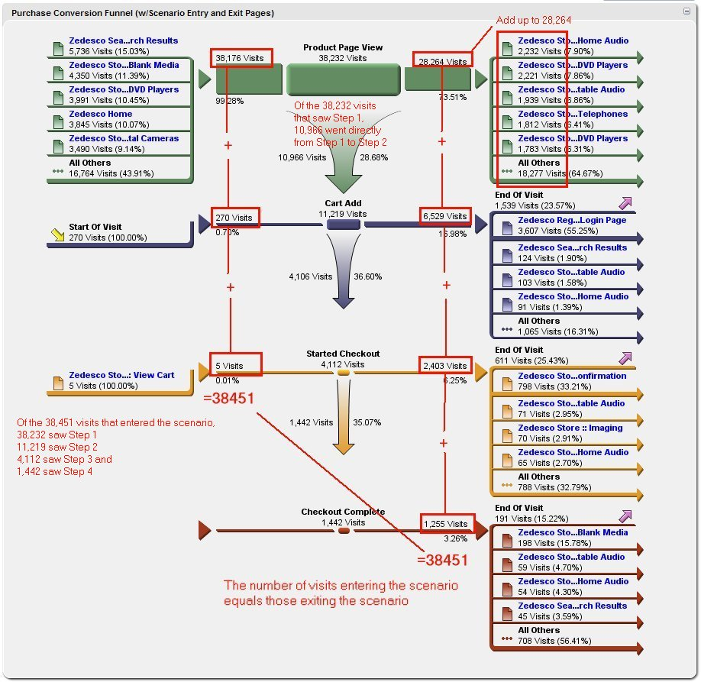

Slide 53
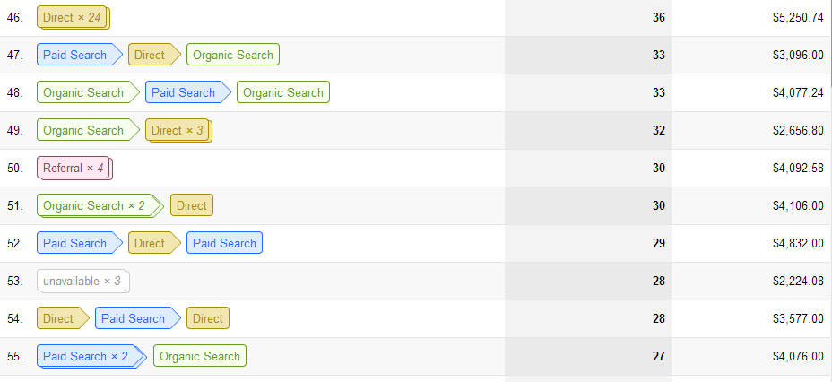
Multi-Channel Funnels
(path to conversion)
Conversions > Multi-Channel Funnels > Top Conversion Paths

Slide 54
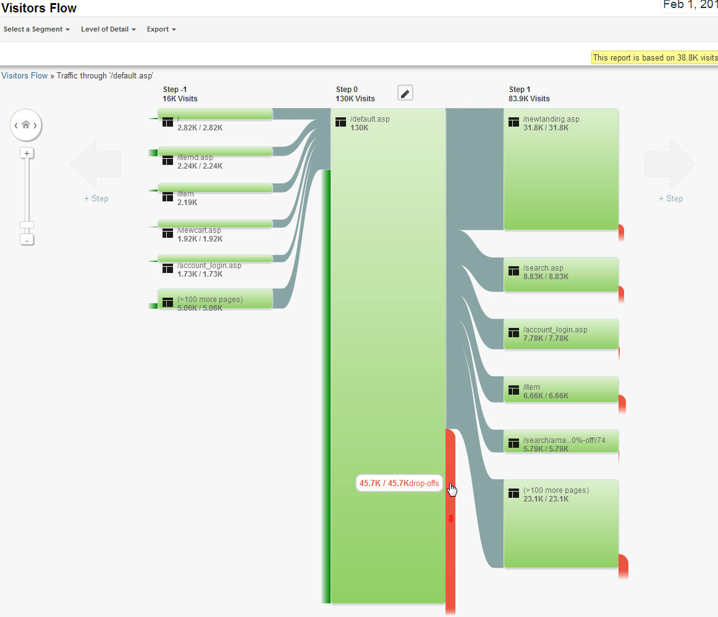
Orange
denotes Fallout

Slide 55
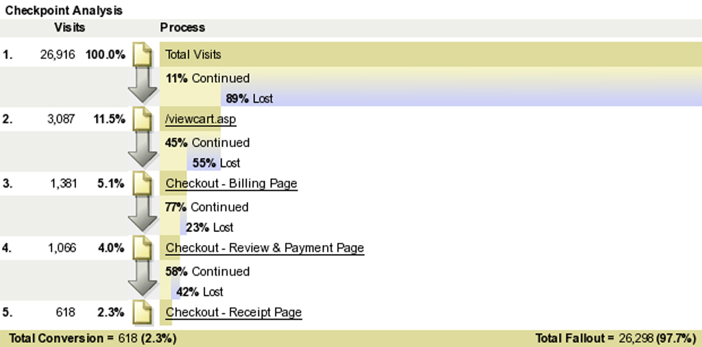
Fallout Report
A variation of the Funnel /Scenario Analysis reports.

Slide 56
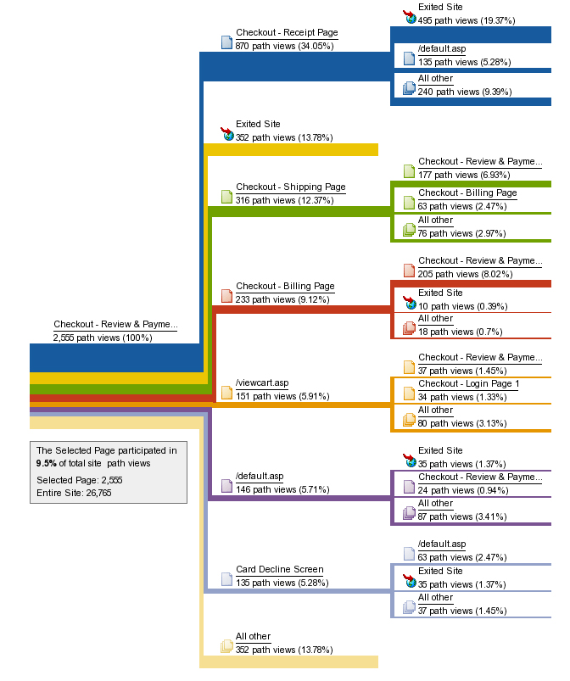
Path reports
Visualize planned and unexpected paths taken by visitors from selected pages
In Google Analytics, use
Pages >Navigation Summary

Slide 57
Campaigns
Marketing campaigns include print ads, web banner advertisements, paid search ads, email ‘blasts’, social media activities, etc.
Tracking code usage and proper tagging appropriate to the tools in use is essential

Slide 58
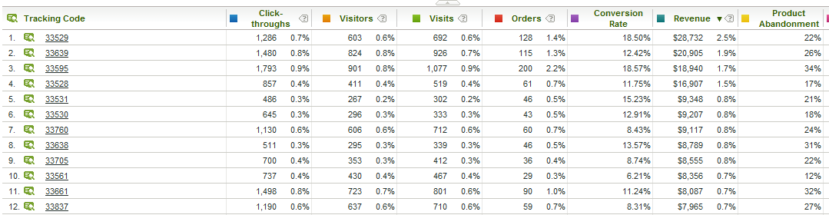
Campaign info availability leads to segmenting
Segment (filter) visitor data to find insight in the groups of visitors passing through your site

Slide 59
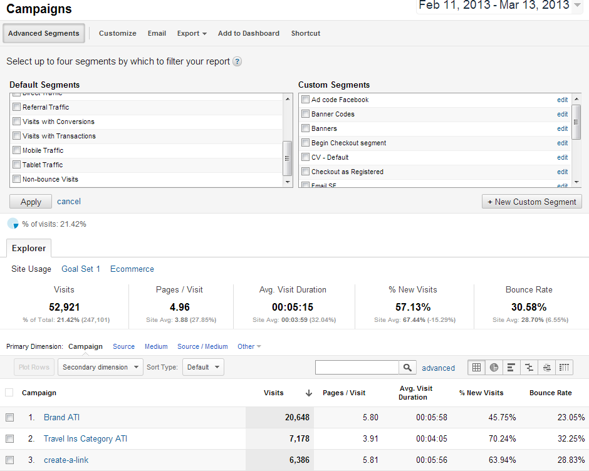

Slide 60
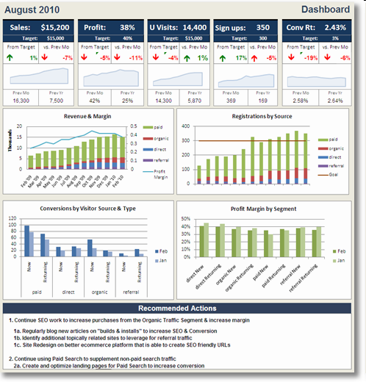
Dashboards
Dashboards summarize your most important reports on a single sheet

Slide 61
Custom Reports
Google Analytics allows users to create Custom Reports using dimensions and metrics to create useful non-standard reports
Previously this capability was available only in enterprise-level (paid) web analytics products

Slide 62
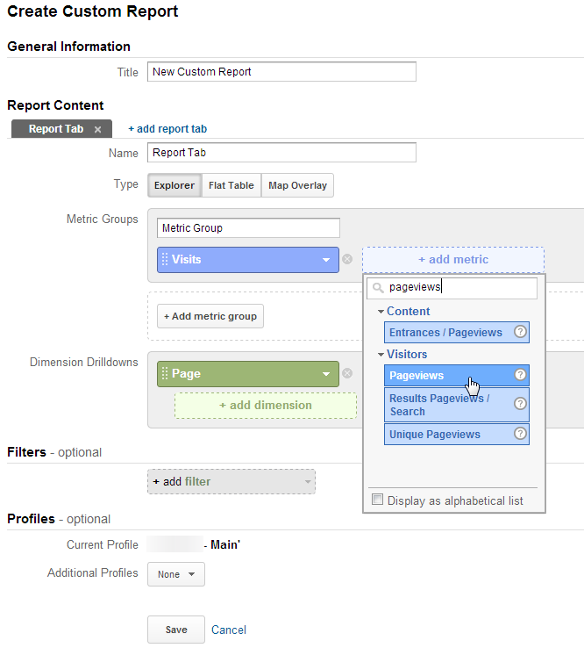
Creating new Custom Reports

Slide 63
Report Delivery
web browser access (standard method)
email delivery of dashboards, alerts,
SMS text messages (usually alerts)
mobile browser access (smartphones, iPad, etc.)
Plugins to client software such as Excel
APIs allow integration with other applications

Slide 64


Data Export
All web analytics tools offer a way to get data out of the system in one format or another, which will allow you to manipulate the data as needed.

Slide 65
Data Validation
If available, attempt to validate and augment your web analytics data with internal systems data
Accounting and fulfillment system (ERP)
CRM systems data
Data warehouse

Slide 66
Augment Web Analytics Reports
Customer Flow
  Can you join web analytics visitor data with data from a downstream system to determine new or existing customers?
Are online visitor actions cost-effective or money saving?
Web self-service vs. phone center costs

Slide 67
Custom tagging
Depending on the web analytics tool in use, special tags (small blocks of code or extra link parameters) are installed on each page of the site
Tags may also be installed on inbound links
These tags provide additional segment and event tracking input for the web analytics tool

Slide 68
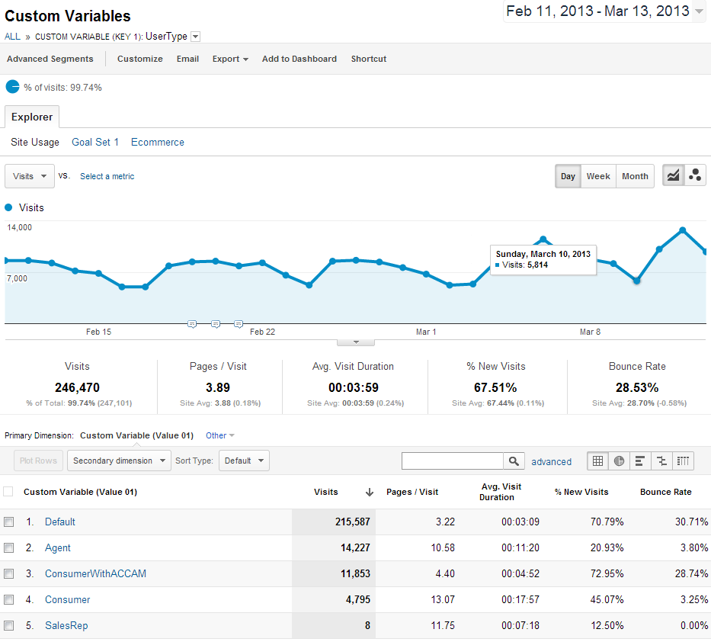

Slide 69
Pitfalls (where did I go wrong?)
Your web analytics tool is not generally a ‘system of record’ such as your CRM or ERP systems, but reports should be reasonable…
Reasons why your reports aren’t accurate:
all pages of the site not tagged (use WASP tool)
tool not implemented properly (used wrong/outdated tags)
lack of understanding and cooperation between marketing and IT
non-qualified or incompletely qualified consultants
data and reports not validated
needs and requirements not correctly specified
Remember that web analytics won’t capture offline sales data (but many systems allow data and event import)

Slide 70
Conclusion
Question and Answer
Clarifications
Google Analytics quick walkthrough

Slide 71
References
Web Analytics 2.0 by A. Kaushik
Web Analytics Demystified
anything by Eric Peterson, Jim Sterne, Jim Novo
Blogs and whitepapers

Slide 72
Thank you! mitchell@onceinaweb.com

