Slide 1
Google Analytics with MyPreventiveCare.org
Mitchell Teixeira
onceinaweb
Aug 22, 2014

Slide 2
Opportunities revealed through Google Analytics data availability
Reach and better serve younger demographic
Better serve mobile users of MPC
(most likely addressing #2 will take care #1)

Slide 3
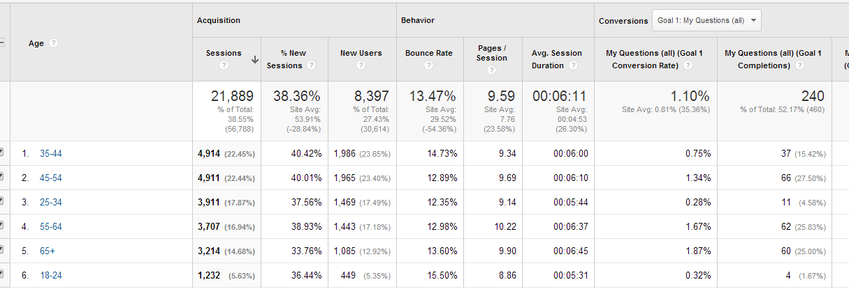
Opportunity reach your younger demographic

Slide 4
Opportunity better serve mobile users

Slide 5
Q&A
Google Analytics walkthrough
What do you want to learn?

Slide 6
Thank you!

