Slide 1
Web Analytics mini case study
Mitchell Teixeira
mitchell@onceinaweb.com

Slide 2
Custom Report
A custom report was created using the dimensions and measures of our choice
We needed a microscope view of scenario analysis allowing visibility down to the visitor level
Able to see visitor’s intent to convert but user interface distractions or system issues prevented goal completion

Slide 3
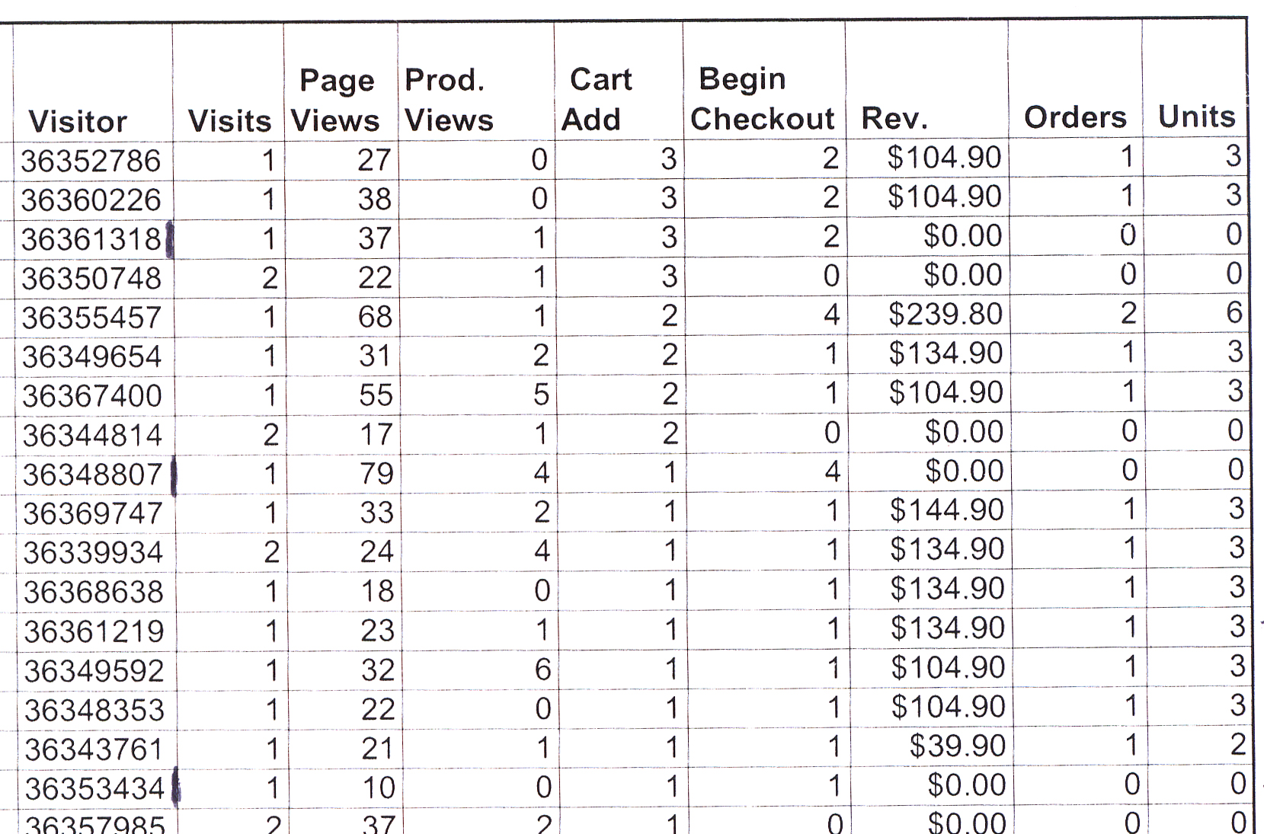
Custom Report

Slide 4
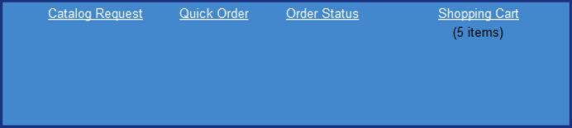
Factor: Poor Navigation Design
Distracting and misleading links shown during checkout process confused visitors

Slide 5
Factor: Underlying system flaws
A back end database with damaged customer record files prevented some customers from completing checkout

Slide 6
Results
Navigation changes made to site. Misleading links removed from page header once customer begins checkout process
The ultimate result was that the client migrated to a new system because of this and other internal system issues with their ERP system

Slide 7
Thank you! mitchell@onceinaweb.com

